Slide 1
Westview Summer Series, 2023

Slide 2
How Many Lost Sheep are/have been Associated with the Westview Church in the Past Five Years?

Slide 3
My Attitude Toward Them Has Been…
Haven’t Given Them Much Thought
Must Work Out Their Own Salvation
Tried to Contact Them Once or Twice
Prayerful and Active Pursuit

Slide 4
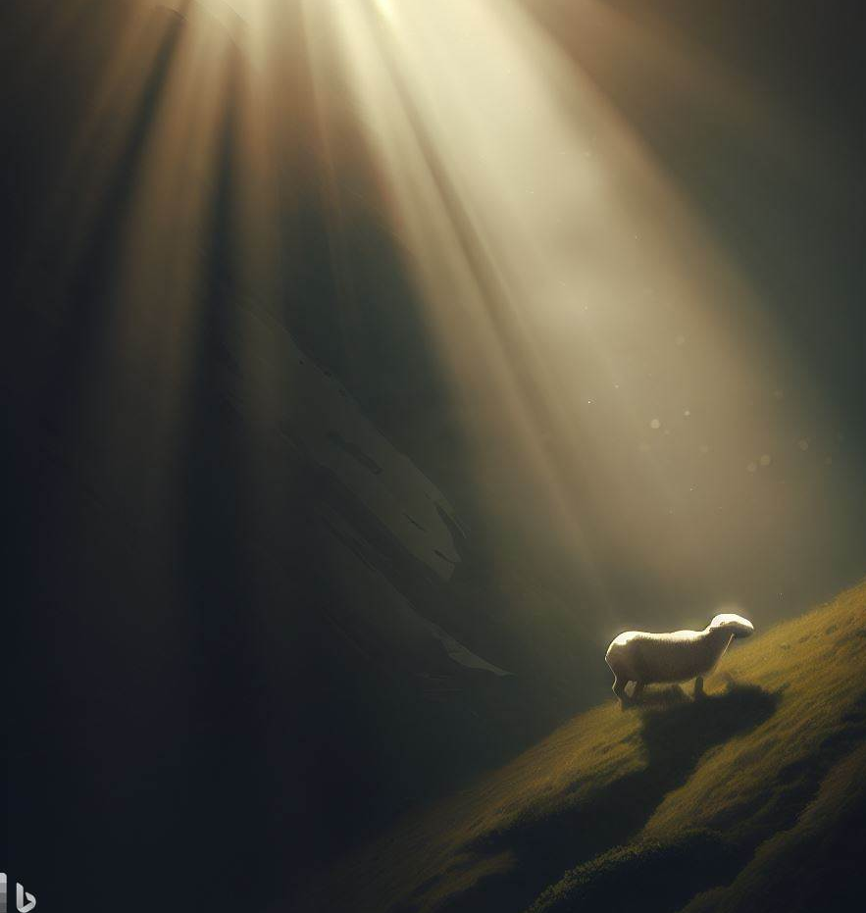
Let Your Light Shine to Lost Sheep

Slide 5
You Who Are Spiritual

Slide 6
You Who Are Spiritual…
Restoration Entrusted to the Spiritual (Galatians 6)
How Does One Become Spiritual?
Walk by the Spirit (16)
Led by the Spirit (18)
Live by the Spirit (25a)
Walk by the Spirit (25b)

Slide 7
You Who Are Spiritual…
The Results of a Spirit Led Life:
Spirit bears fruit through you (22-23)
Flesh is crucified, with passions and desires (24)
Conceit, provocation, envy are removed (26)
How Do You Know If You Are Spiritual?

Slide 8
But I say, walk by the Spirit, and you will not gratify the desires of the flesh. […] But if you are led by the Spirit, you are not under the law. Now the works of the flesh are evident: sexual immorality, impurity, sensuality, idolatry, sorcery, enmity, strife, jealousy, fits of anger, rivalries, dissensions, divisions, envy, drunkenness, orgies, and things like these. I warn you, as I warned you before, that those who do such things will not inherit the kingdom of God. But the fruit of the Spirit is love, joy, peace, patience, kindness, goodness, faithfulness, gentleness, self-control; against such things there is no law. And those who belong to Christ Jesus have crucified the flesh with its passions and desires. If we live by the Spirit, let us also walk by the Spirit. Let us not become conceited, provoking one another, envying one another. Brothers, if anyone is caught in any transgression, you who are spiritual should restore him in a spirit of gentleness

Slide 9
But I say, walk by the Spirit, and you will not gratify the desires of the flesh. […] But if you are led by the Spirit, you are not under the law. Now the works of the flesh are evident: sexual immorality, impurity, sensuality, idolatry, sorcery, enmity, strife, jealousy, fits of anger, rivalries, dissensions, divisions, envy, drunkenness, orgies, and things like these. I warn you, as I warned you before, that those who do such things will not inherit the kingdom of God. But the fruit of the Spirit is love, joy, peace, patience, kindness, goodness, faithfulness, gentleness, self-control; against such things there is no law. And those who belong to Christ Jesus have crucified the flesh with its passions and desires. If we live by the Spirit, let us also walk by the Spirit. Let us not become conceited, provoking one another, envying one another. Brothers, if anyone is caught in any transgression, you who are spiritual should restore him in a spirit of gentleness

Slide 10
You Who Are Spiritual…
How Do You Know if You Are Spiritual?
Your concern is restoration of those transgressing
Restoration is done in spirit of gentleness
You are willing to bear another’s burden
You help and do not add additional burdens
They [Pharisees] tie up heavy burdens, hard to bear, and lay them on people's shoulders, but they themselves are not willing to move them with their finger – Matthew 23:4

Slide 11
You Who Are Spiritual…
How Do You Know if You Are Spiritual?
Your concern is restoration of those transgressing
Restoration is done in spirit of gentleness
You are willing to bear another’s burden
Standing not measured by another’s weakness
Am I Spiritual?

Slide 12
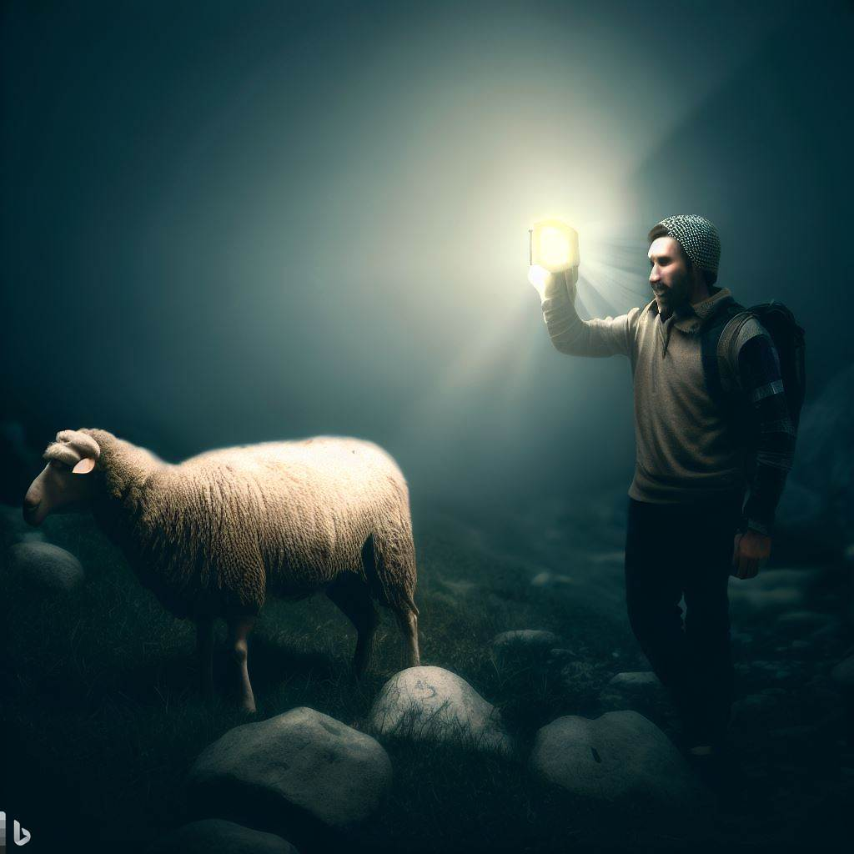
Letting My Light Shine to Lost Sheep

Slide 13
Letting My Light Shine to Lost Sheep
Support Your Shepherds
Their job is to encourage spirituality
They bring sheep to the water and sheep must drink
Help them by assisting in strengthening the weak
Obey your leaders and submit to them, for they are keeping watch over your souls, as those who will have to give an account. Let them do this with joy and not with groaning, for that would be of no advantage to you – Hebrews 13:17

Slide 14
Letting My Light Shine to Lost Sheep
Support the Sheep
Light shining in church building won’t help the lost
We must be more than bench mates!
Deep relationships are essential
And we urge you, brothers, admonish the idle, encourage the fainthearted, help the weak, be patient with them all. – I Thessalonians 5:14

Slide 15
Letting My Light Shine to Lost Sheep
Support the Sheep
How Do I Know Who Needs Help?
Not when one stops attending
Through building relationships
Hospitality
Meaningful conversations
Listening, not lecturing
Showing trustworthiness

Slide 16
Letting My Light Shine to Lost Sheep
Support the Sheep
Don’t Give Up!

Slide 17
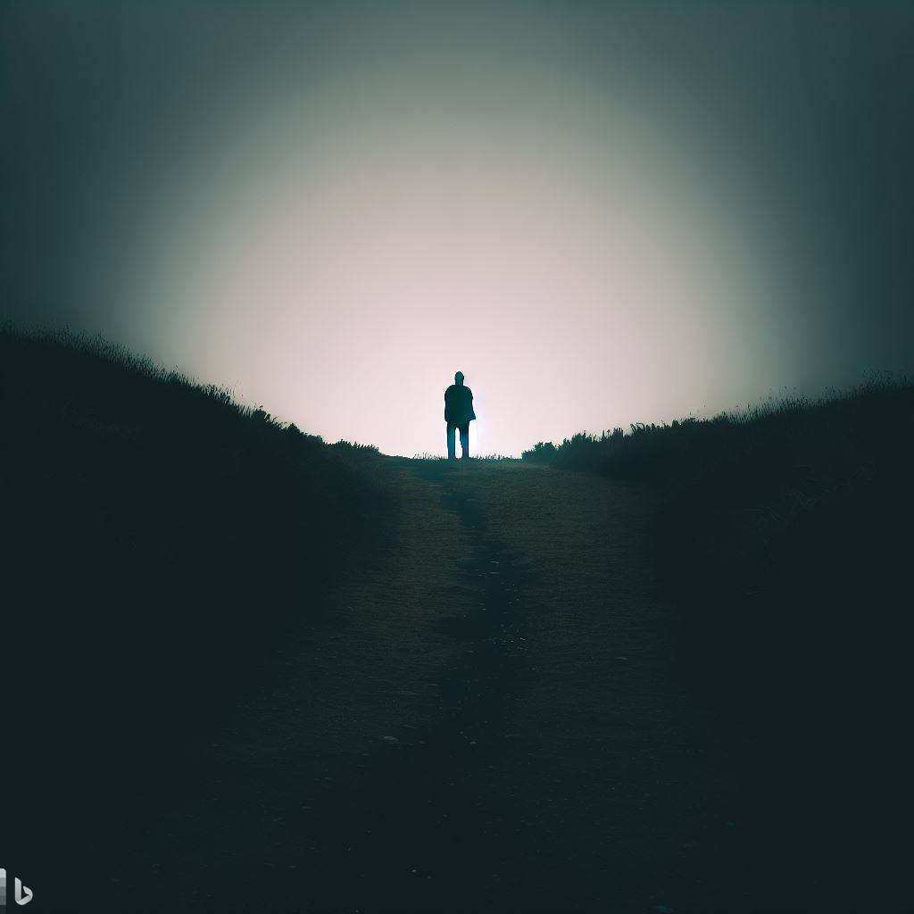
“What Advice Would You Give to Someone Who Has Had a Loved One Fall Away”?
Be very patient. It takes some people longer to realize where they are. Always be there and don’t ever give up on them. Perhaps it will be the 105th time they finally listen. Let them know you want what is best for their eternal soul.
Christians may feel they haven’t done any good because the wayward didn’t do anything right away, but the wayward will remember all the cards and visits and prayers. I remember all the cards I got. I wasn’t ready emotionally then, but God gave me time.
Return to Me: What to do When Loved Ones Fall Away
-- Kathy Pollard

Slide 18
Letting My Light Shine to Lost Sheep
Support the Sheep
Don’t Give Up!
Writing a note by hand to show love
Texting a verse of encouragement
Phone call of concern (even if not answered)
Pray continually (congregationally/privately)
Never “one and done”

Slide 19
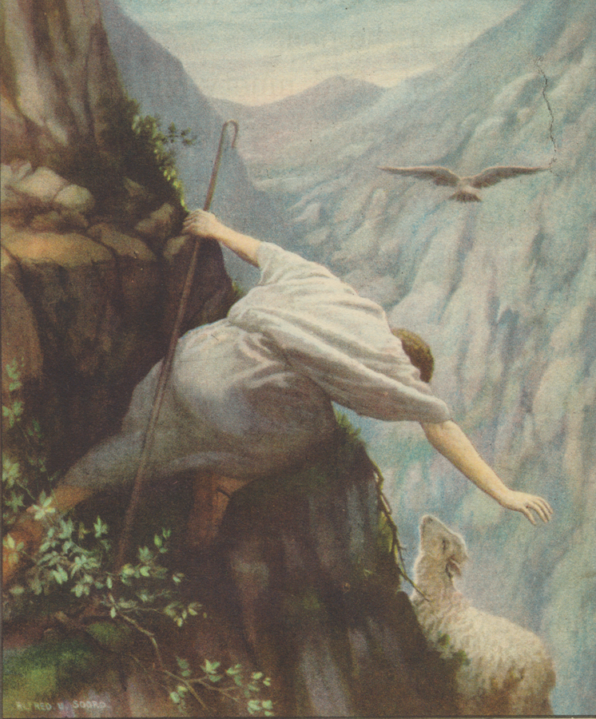
My brothers, if anyone among you wanders from the truth and someone brings him back, let him know that whoever brings back a sinner from his wandering will save his soul from death and will cover a multitude of sins.
-- James 5:19-20

