Slide 1
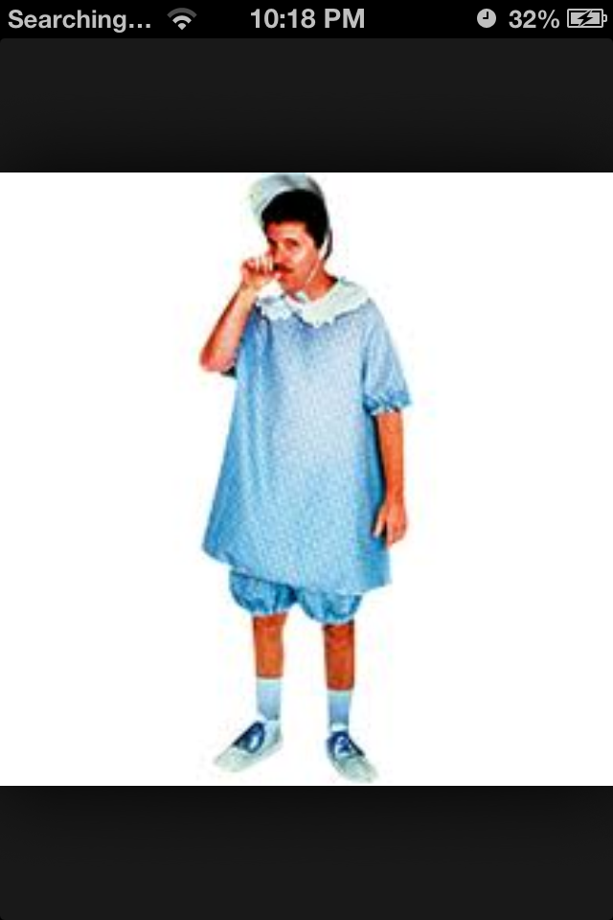
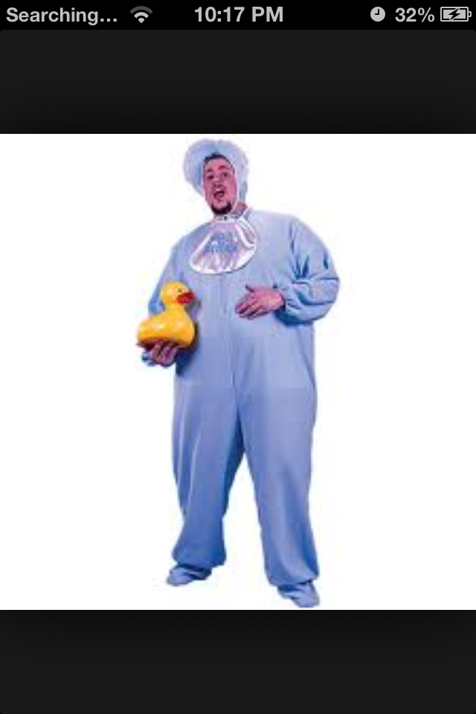

Slide 2
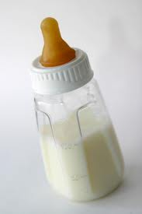
Milk Bottle Christians
Hebrews
5:11-6:3

Slide 3
Spiritual Immaturity Can Become Very Severe
Hebrews 5:11-12
-They were “dull of hearing.”
- (John 8:43) “Why do you not understand My speech? Because you are not able to listen to my word.”
- They should have been more advanced!
- They had “come to need milk and not solid food.”

Slide 4
Spiritual Immaturity Can Become Very Severe
Hebrews 5:11-12
1 Corinthians 3:1-2 And I, brethren, could not speak to you as to spiritual people but as to carnal, as to babes in Christ. 2 I fed you with milk and not with solid food; for until now you were not able to receive it, and even now you are still not able;

Slide 5
Spiritual Immaturity Is Sometimes “Sinful”
Hebrews 5:13
- At some point it becomes a choice to partake only
milk.
- What point?...
The point at which the “basics” have
been learned.

Slide 6
Spiritual Immaturity Is Sometimes “Sinful”
1 Corinthians 14:20 Brethren, do not be children in understanding; however, in malice be babes, but in understanding be mature.
2 Peter 1:5-10 – “Add to your faith…”
Luke 2:52 And Jesus increased in wisdom and stature, and in favor with God and men.

Slide 7
Spiritual Immaturity Is A Serious Loss
Hebrews 5:14
1.) A loss to “self”
-(1 Cor.2:14) “But the natural man does not receive the things of the Spirit of God, for they are foolishness to him; nor can he know them, because they are spiritually discerned.”
(Rom.8:6) “For to be carnally minded is death, but to be spiritually minded is life and peace.”

Slide 8
Spiritual Immaturity Is A Serious Loss
Hebrews 5:12a
2.) A loss to “others”
- If one should be a teacher “by this time” and they
and they are not… then someone is without a
teacher.
(2 Cor.3:2-3) We should be “living epistles”

Slide 9
Get Past The ABC’s
Hebrews 6:1-2
- Don’t forget the ABC’s!......Build upon them!
- 1 Peter 2:2 “as newborn babes, desire the pure milk of the word that you may grow thereby.”
John 6:53-57- Jesus said we must partake of Him.
- Milk is not enough!
- We must learn to “eat” and “feed upon” the Word.

Slide 10
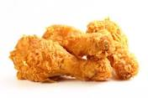
Get Past The ABC’s
We need some “Spiritual FRIED CHICKEN”!

Slide 11
Be Determined To Grow
Hebrews 6:3
Matthew 5:6 “Blessed are those who hunger and thirst for righteousness, for they shall be filled.”
Begin to study, talk to God, worship in spirit and truth, give with a purpose, keep focus, discern good from evil, etc…
ALLOW THE BIBLE TO COME TO LIFE IN YOU!

Slide 12
“We fear that the Bible is far more widely circulated than read, and far more extensively read than studied or understood.” (Pulpit Commentary)
This is the reason that Satan wins the battle so often…
~ We are often prepared on the smallest most
elementary level.
~ Satan is very well versed and learned.

Slide 13
Conclusion
(Psalm 1:1-2) “Blessed is the man who walks not in the counsel of the ungodly, not stands in the path of sinners, nor sits in the seat of the scornful; but his delight is in the law of the Lord, and in His law he meditates day and night.”
Let His word be your desire and delight and GROW thereby!

Slide 14
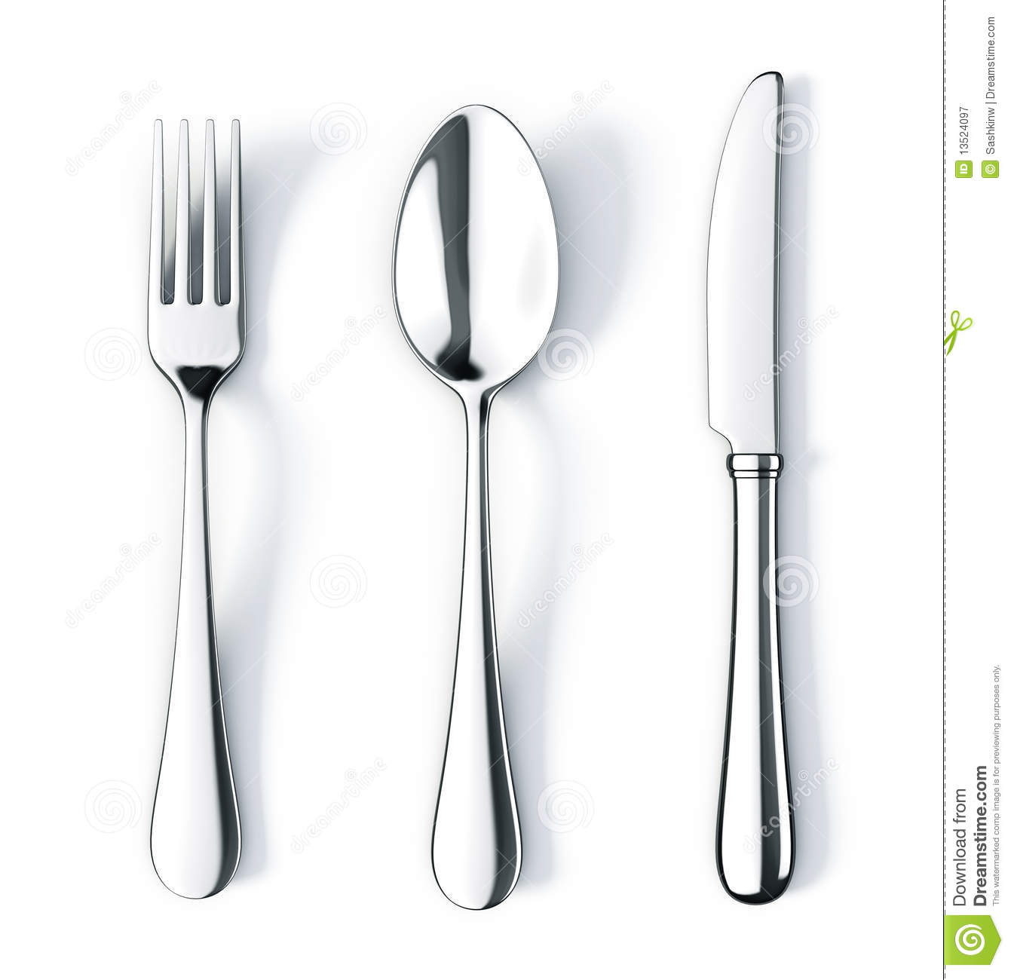
OR

