Slide 1
“Every part does its share”
Eph. 4:11-16

Slide 2
Nehemiah
Cupbearer for King Artaxerxes
Heard of the difficulty of his people in Jerusalem and the condition of the walls
With permission from Artaxerxes led a group of exiles back to Jerusalem to rebuild the walls of the city
Organized and led the people to ‘get to work’ and rebuild the walls of the city

Slide 3
Nehemiah
Neh. 2:18 - …So they said, “Let us rise up and build.” Then they set their hands to this good work.
Nehemiah provided great leadership for his people.
  Their circumstances had a great emotional impact
  He identified with his people and their circumstances
  He was willing to ‘sacrifice and work’ together with those he led

Slide 4
Nehemiah 3
Time To Get Their Hands Dirty
Rebuilding the Wall
Notice how detailed the work
Notice who is doing the work
Different levels of society
Men and women

Slide 5
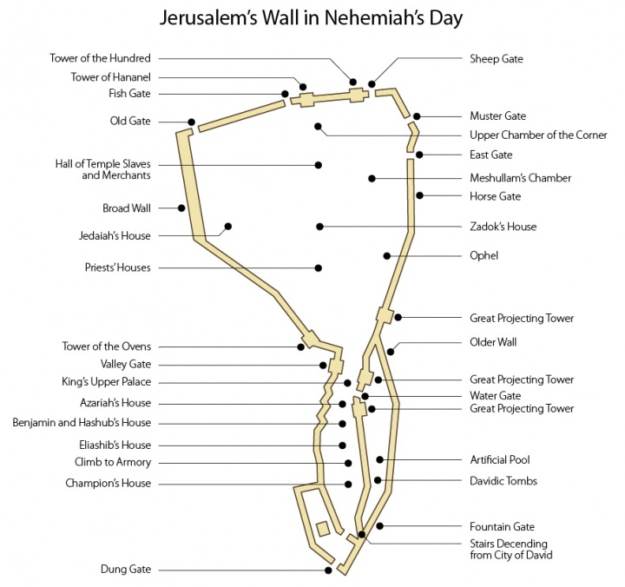

Slide 6
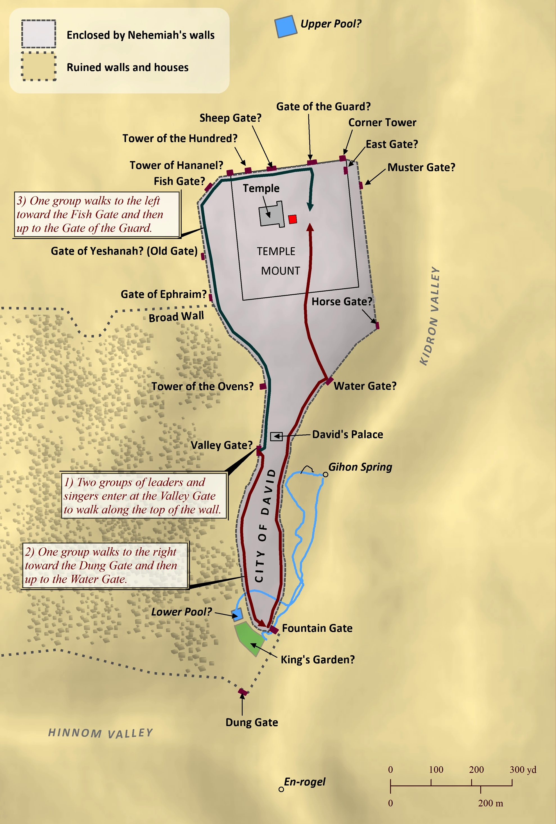

Slide 7
Lessons We Learn From Neh. 3
Two Primary Lessons
  Each part of the wall was important
  Each individual worker was important

Slide 8
Two Important Lessons
Importance of Each Section of the Wall
  By the name of gates and towers you realize each one had a very important purpose
  A partial wall would provide no protection at all to the city
  Notice that every detail is important even down to the bolts and hinges of the gates

Slide 9
Two Important Lessons
Each Individual Worker Was Important
  Population of Jerusalem very small compared to the time before Babylonian captivity
  Each person had a role in accomplishing the task
  “Every part does its share” (Eph. 4:16)

Slide 10
Lessons For Us
Worked With Unity of Purpose
  A lot of different people mentioned in Neh. 3
  Building a wall that’s 1 ½ in diameter with 40 different sections
  Everything has to fit together when the work is done.
  Notice a recurring phrase, “next to them”
  They worked shoulder to shoulder for 52 days and finished the wall.

Slide 11
Lessons For Us
Unity of Purpose
  To be successful, God’s people must work together with this type of commitment and unity.
Problems At Corinth – 1 Cor 12
  Between ch. 12 is ch. 11 and 13
  1 Cor. 11:17 - divisions
  1 Cor. 13 – the need for love
There was unity of purpose in Neh. 3, but they were very different in background, skill and gifts.
    Priests
    Levites (V17)
    Many people outside of Jerusalem (Tekoa, Jericho)
    Goldsmiths
    Perfumers
    Daughters
    They all became craftsmen at masonry

Slide 12
Lessons For Us
Different Responses to the Work
  Most worked, some worked double
  Meremoth (v4, 21)
  Tekoaties (v5, 27)
  Hanun (v13, 30)
  Some did nothing (v5)

