Slide 1
“A royal Priesthood”
”YOU ARE…”

Slide 2
Old testament priests
Exodus 29 – Tasks to Consecrate the Priests
1) Washings (vs 4)
2) Putting on the proper garments (vs 5-6 & 8-9)
3) Anointing with oil (vs 7)
4) Sacrificing (vs 10-19)
5) Anointing with blood(vs 20-21)
6) Eating the sacrificed animal (vs 32)

Slide 3
Old testament priests
Exodus 29 – Tasks to Consecrate the Priests
Sacrificing the Consecration Ram
Blood would be placed on Aaron and his sons:
Right Ear Lobe
Right Thumb
Right Big Toe
WHY?

Slide 4
Old testament priests
Leviticus 8:22-24
Sacrificing the Consecration Ram
Blood would be placed on Aaron and his sons:
Right Ear Lobe
Right Thumb
Right Big Toe
WHY?

Slide 5
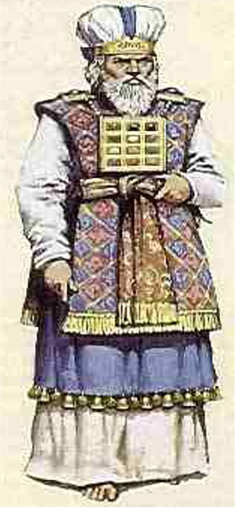
Old testament priests
Right Ear Lobe = Hear the Word of the Lord!
Right Thumb = Do What the Lord Says to Do!
Right Big Toe= Follow the Lords Path!

Slide 6
Old testament priests
Priests were to: (Deut. 33:6-8)
Trust in God’s Word
Follow God’s Word
Teach &. Lead the Israelites

Slide 7
New testament priests
Our Great High Priest – Jesus Christ
Hebrews 5:1-10
Priests = The Saints / Followers of Christ
Rev. 1:5-6

Slide 8
“.. To Him who loved us and washed us from our sins in His own blood and has made us kings and priests to His God and Father, to Him be glory and dominion forever and ever. Amen”
Rev. 1:5-6

Slide 9
New testament priests
The Blood Has Been Applied to NT Priests!
It cleanses us (Eph. 1:7 / 1 John 1:7)

Slide 10
“In Him we have redemption through His blood, the forgiveness of sins, according to the riches of His grace..”
Eph. 1:7
”But if we walk in the light as He is in the light, we have fellowship with one another, and the blood of Jesus Christ His Son cleanses us from all sin.”
1 Jn. 1:7

Slide 11
New testament priests
The Blood Has Been Applied to NT Priests!
It cleanses us (Eph. 1:7 / 1 John 1:7)
It sanctifies us (Heb. 9:13-14)

Slide 12
For if the blood of bulls and goats and the ashes of the heifer, sprinkling the unclean, sanctifies for the purifying of the flesh, how much more shall the blood of Christ, who through the eternal Spirit offered Himself without spot to God, cleanse your consciences from dead works to serve the living God?”
Heb. 9:13-14

Slide 13
New testament priests
The Blood Has Been Applied to NT Priests!
It cleanses us (Eph. 1:7 / 1 John 1:7)
It sanctifies us (Heb. 9:13-14)
Emblem used to remind us of our covenant with God
Matt. 26:27 - ”For this is my blood of the new covenant, which is shed for many for the remission of sins.”

Slide 14
New Testament priests
Your Ears:
True Followers Listen to Jesus
“My sheep hear My voice, and I know them, and they follow Me.”
John 10:27

Slide 15
New Testament priests
Your Ears:
True Followers Listen to Jesus
What Kind of Ears Do I Have?
Dull (Heb. 5:10)
Itching (2 Tim. 4:3-4)
Hearing (1 Sam. 3:10 – “Speak, for your servant hears.”)

Slide 16
New Testament priests
Your Ears:
Your Hands:
Hands should be fit for the kingdom of God! (Luke 9:62)
NT Priests are called to use our hands for good! ( Eph. 4:28 / 1 Thess. 4:11-12)

Slide 17
“Let him who stole steal no longer, but rather let him labor, working with his hands what is good, that he may have something to give him who has need.” Eph. 4:28
“..that you may aspire to lead a quiet life, to mind your own business, and to work with your own hands, as we commanded you, that you may walk properly toward those who are outside, and that you may lack nothing.”
1 Thess. 4:11-12

Slide 18
New Testament priests
Your Ears:
Your Hands:
Your Feet:
We are to avoid paths leading to sin (Ps. 1:1 / Prov. 1:15)

Slide 19
“Blessed is the man who walks not in the counsel of the ungodly, Nor stands in the path of sinners, Nor sits in the seat of the scornful..”
Psalms 1:1
”My son, do not walk in the way with them, keep your foot from their path..”
Proverbs 1:15

Slide 20
New Testament priests
Your Ears:
Your Hands:
Your Feet:
We are to avoid paths leading to sin (Ps. 1:1 / Prov. 1:15)
We are able to walk a new path through Jesus (Rom. 6:4)
Faithfulness (or lack thereof) is shown by how we walk (Eph. 2:1-2 & 10)

Slide 21
“A royal Priesthood”
”YOU ARE…”

