Slide 1
Sermon on the mount
Matthew 5-7

Slide 2
the Kingdom of heaven
This sermon is much more than a series of ethical or moral platitudes.
This sermon was part of a core message that Jesus continually tried to press upon His listeners.
This core message is “The Kingdom of Heaven”
The King – Jesus
The Kingdom Citizens – His followers
The Reign – The rule and reign of Jesus

Slide 3
the Kingdom of Heaven in matthew
Matthew 3:2 - and saying, “Repent, for the kingdom of heaven is at hand!”
Matthew 4:17 -…“Repent, for the kingdom of heaven is at hand.”
Matthew 5:3 - “Blessed are the poor in spirit, For theirs is the kingdom of heaven.
Matthew 5:10 - Blessed are those who are persecuted for righteousness’ sake, For theirs is the kingdom of heaven
Matthew 5:20 - For I say to you, that unless your righteousness exceeds the righteousness of the scribes and Pharisees, you will by no means enter the kingdom of heaven.
Matthew 7:21 - “Not everyone who says to Me, ‘Lord, Lord,’ shall enter the kingdom of heaven, but he who does the will of My Father in heaven
Matthew 10:7 - And as you go, preach, saying, ‘The kingdom of heaven is at hand.

Slide 4
The kingdom of heaven in matthew
Matthew 13:11 - He answered and said to them, “Because it has been given to you to know the mysteries of the kingdom of heaven, but to them it has not been given.
Matthew 13:24 - Another parable He put forth to them, saying: “The kingdom of heaven is like a man who sowed good seed in his field;
Matthew 13:31 - Another parable He put forth to them, saying: “The kingdom of heaven is like a mustard seed, which a man took and sowed in his field,
Matthew 13:33 - Another parable He spoke to them: “The kingdom of heaven is like leaven, which a woman took and hid in three measures of meal till it was all leavened.”
Matthew 13:44 - “Again, the kingdom of heaven is like treasure hidden in a field, which a man found and hid; and for joy over it he goes and sells all that he has and buys that field.

Slide 5
the kingdom of heaven in matthew
Matthew 13:4- “Again, the kingdom of heaven is like a merchant seeking beautiful pearls,
Matthew 16:19 - And I will give you the keys of the kingdom of heaven, and whatever you bind on earth will be bound in heaven, and whatever you loose on earth will be loosed in heaven.”
Matthew 18:3 - and said, “Assuredly, I say to you, unless you are converted and become as little children, you will by no means enter the kingdom of heaven
Matthew 22:2 - “The kingdom of heaven is like a certain king who arranged a marriage for his son
Matthew 23:13 - “But woe to you, scribes and Pharisees, hypocrites! For you shut up the kingdom of heaven against men; for you neither go in yourselves, nor do you allow those who are entering to go in.

Slide 6
The kingdom heaven is at hand – Mt. 4:17
What would this message mean to the people Jesus’ is preaching to?
Remember the ‘Big Picture’ of the Bible
“Everything that is in the Bible finds its origin or points back to the first two or three pages of the book of Genesis”
Matt.19 – “in the beginning”

Slide 7
Reign and rule of God
Story of Creation – Gen. 1:27-28
Then God said, “Let Us make man in Our image, according to Our likeness; let them have dominion over the fish of the sea, over the birds of the air, and over the cattle, over [g]all the earth and over every creeping thing that creeps on the earth.” 27 So God created man in His own image; in the image of God He created him; male and female He created them. 28 Then God blessed them, and God said to them, “Be fruitful and multiply; fill the earth and subdue it; have dominion over the fish of the sea, over the birds of the air, and over every living thing that moves on the earth.”

Slide 8
Reign and rule of God
God created man to ‘rule’ with Him over creation in a sinless and paradise environment.
Man rebelled against God’s plan and tried to ‘usurp’ this kingdom and set up ‘kingdom’s of this world’.
God will rescue a remnant of Abraham’s people out of Egypt and they will become a great kingdom. They too will rebel against God and pervert this kingdom.
The OT prophets promised that God will bring forth a new king who will restore what has been lost.
Jesus has announced – “That Kingdom is at hand”

Slide 9
Sermon on the mount
The Setting – Great multitudes followed Him
Fishermen
Poor
Sick people
Demon possessed
Paralytics
Epileptics
He invites these people who seem to be nobodies and nothings to citizens of His Kingdom.

Slide 10
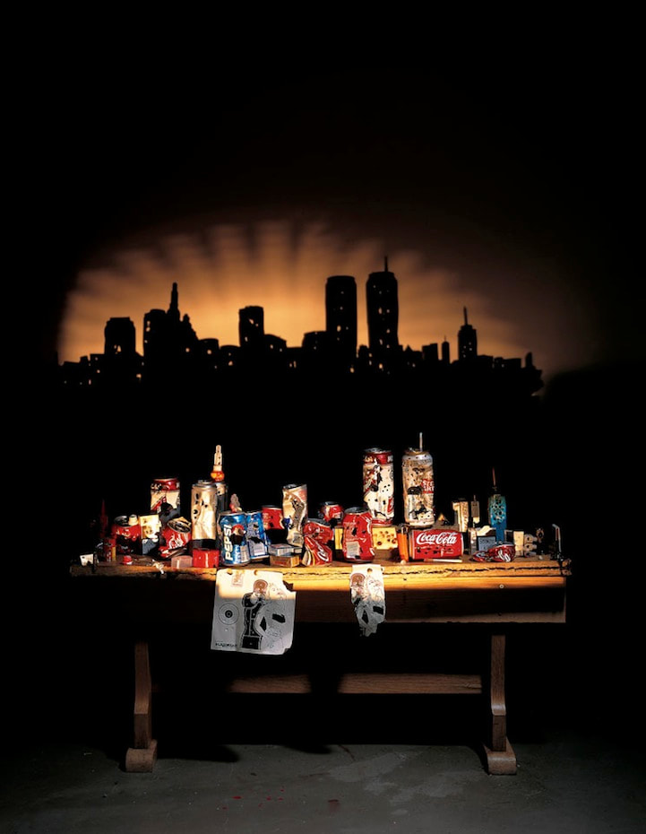
Tim noble and sue webster – shadow art

Slide 11
Things change when you add the light

Slide 12
Sermon on the Mount – The Beattitudes
Jesus pronounces blessings upon these kingdom recipients
None of which seem to be a blessing at all…
In fact these seem to be paradoxical statements
Jesus often used this form of teaching to reveal deeper truths
“If you gain your life you shall lose it”
“If you lose your life for My sake you shall gain it”
“The first shall be last, the last shall be first”

Slide 13
the beattitudes – Matt. 5:1-10
Blessed are the poor
Blessed are those that mourn
Blessed are the meek
Blessed are those who hunger and thirst for righteousness
Blessed are the merciful
Blessed are the pure in heart
Blessed are the peacemakers
Blessed are those who are persecuted

