Slide 2
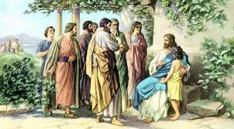
Matthew 18:2
Then Jesus called a little child to Him, set him in the midst of them…

Slide 3
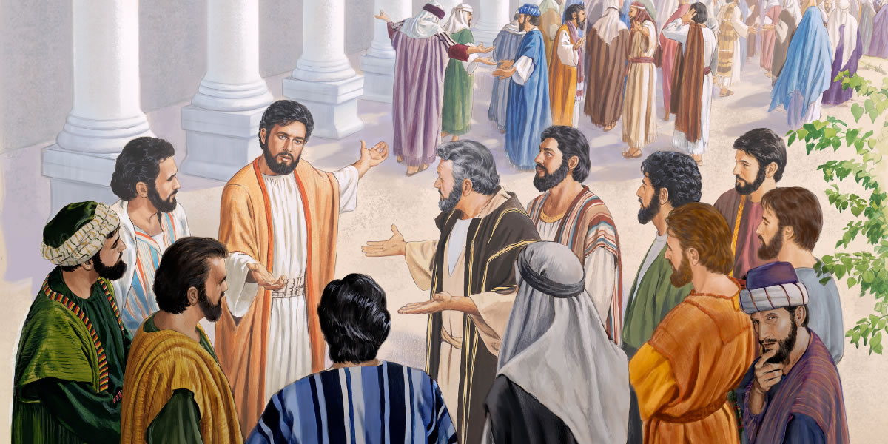
Mark 9:33-37
The Disciples Argue About Greatness

Slide 4
Like A Little Child
Matthew 18:1-4 / Mark 9:33-37

Slide 5
2 Questions Must Be Answered:
Why did Jesus call the child?
Why did the child come to Jesus?

Slide 6
Why did Jesus call the child?
The disciples had a great need to be “converted”
This child was a picture of what they needed to become.
Trusting, surrendering, obedient, humble.
Acts 3:19 Repent therefore and be converted, that your sins may be blotted out, so that times of refreshing may come from the presence of the Lord,

Slide 7
Why did Jesus call the child?
B) He wanted to save the “children” from danger.
Jesus may have called this child….
However, His point was that the disciples were still in the category of (children/babes).
They too needed to be saved from danger.

Slide 8
Why did Jesus call the child?
B) He wanted to save the “children” from danger.
Ephesians 6:16 Above all, taking the shield of faith with which you will be able to quench all the fiery darts of the wicked one.
This child would soon be in danger of the fiery darts of Satan.
The disciples would “especially” be in danger of Satan’s darts!

Slide 9
Why did Jesus call the child?
He wanted to save the “children” from danger.
1Timothy 1:15 This is a faithful saying and worthy of all acceptance, that Christ Jesus came into the world to save sinners, of whom I am chief.
Matthew 23:37 "O Jerusalem, Jerusalem, the one who kills the prophets and stones those who are sent to her! How often I wanted to gather your children together, as a hen gathers her chicks under her wings, but you were not willing!

Slide 10
Why did Jesus call the child?
He wanted to save the “children” from danger.
When Jesus looked at this child, He saw a small frame that was controlled by a huge heart.
He saw humility and surrender
He saw someone who was willing to be helped
The disciples however… were not near as willing to come as they were arguing about greatness.

Slide 11
2. Why did the child come to Jesus?
Because the child was “humble”
Humility allows you to approach the bosom of Jesus.
Isaiah 57:15 For thus says the High and Lofty One Who inhabits eternity, whose name is Holy: "I dwell in the high and holy place, With him who has a contrite and humble spirit, To revive the spirit of the humble, And to revive the heart of the contrite ones.

Slide 12
2. Why did the child come to Jesus?
The child….
- Gave up what he was doing… unlike Martha
Luke 10:41 And Jesus answered and said to her, "Martha, Martha, you are worried and troubled about many things.

Slide 13
2. Why did the child come to Jesus?
The child….
- Gave up what he was doing… unlike Martha
- Obeyed in humility
James 4:10 Humble yourselves in the sight of the Lord, and He will lift you up.
1 Peter 5:5 Likewise you younger people, submit yourselves to your elders. Yes, all of you be submissive to one another, and be clothed with humility, for "GOD RESISTS THE PROUD, BUT GIVES GRACE TO THE HUMBLE."

Slide 14
2. Why did the child come to Jesus?
The child….
- Gave up what he was doing… unlike Martha
- Obeyed in humility
- Overcame apprehension
- Felt a need to go
- Had a natural tendency to be “loved”
- The child “wanted to go”

Slide 15
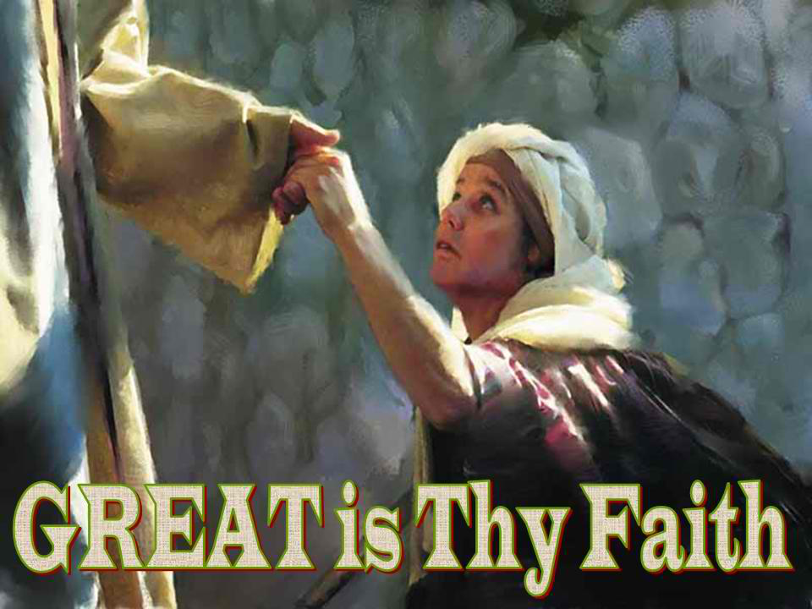
Matthew 15:25-28
Are you willing to eat the crumbs?

Slide 16
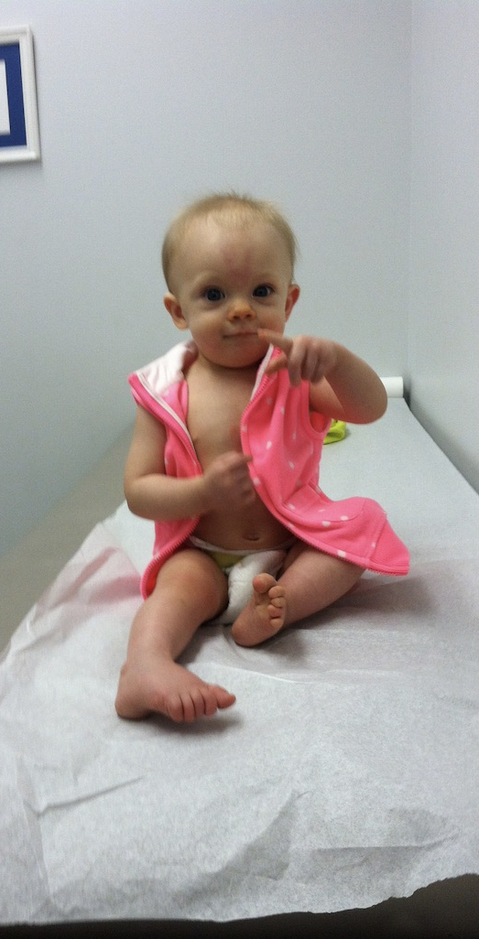
At what point along the pathway in life do we stop trusting as we once did as children?

Slide 17
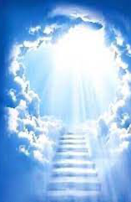
Why should we be like little children?.....
Because the door of the kingdom of God is not found through greatness!
Proverbs 3:5-6
Trust in the LORD with all your heart, And lean not on your own understanding; In all your ways acknowledge Him, And He shall direct your paths.

Slide 18
Why was Jesus so drawn to children?
Mark 10:14 But when Jesus saw it, He was greatly displeased and said to them, "Let the little children come to Me, and do not forbid them; for of such is the kingdom of God.
Mark 10:15-16 Assuredly, I say to you, whoever does not receive the kingdom of God as a little child will by no means enter it." And He took them up in His arms, laid His hands on them, and blessed them.
Will you become “Like a little child?”

