Slide 1
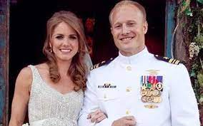
LCDR: Lief Babin

Slide 2
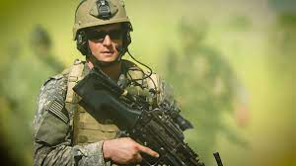
Michael A. Monsoor, Navy Seal

Slide 3
Answering the Call in theFace of Danger
Barzillai – 2 Samuel 17-19

Slide 4
Low Point of David’s Reign
Absolam led a rebellion against his father
David flees from the throne and is deeply shaken in spirit and faith (2 Sam. 15:13-14)
13) Now a messenger came to David, saying, “The hearts of the men of Israel are with Absalom.”
So David said to all his servants who were with him at Jerusalem, “Arise, and let us flee, or we shall not escape from Absalom. Make haste to depart, lest he overtake us suddenly and bring disaster upon us, and strike the city with the edge of the sword.”
Doesn’t sound like the David that had slain his ten thousands.

Slide 5
Low Point of David’s Reign
Absolam led a rebellion against his father
David shows doubt and fear instead of confidence and courage (2 Sam. 15:25-26)
25) Then the king said to Zadok, “Carry the ark of God back into the city. If I find favor in the eyes of the Lord, He will bring me back and show me both it and His dwelling place. 26) But if He says thus: ‘I have no delight in you,’ here I am, let Him do to me as seems good to Him.”
Before: “the Lord shall deliver me out of the hand of this Philistine”
Now: “Maybe God will deliver me, maybe he won’t”

Slide 6
Answering the Call
The narrator of this story doesn’t focus on the coup but on the different characters and their loyalty or disloyalty to David
Many will answer David’s call for support and help (2 Sam. 17:27-29)
27 ,) Now it happened, when David had come to Mahanaim, that Shobi the son of Nahash from Rabbah of the people of Ammon, Machir the son of Ammiel from Lo Debar, and Barzillai the Gileadite from Rogelim, 28) brought beds and basins, earthen vessels and wheat, barley and flour, parched grain and beans, lentils and parched seeds, 29 honey and curds, sheep and cheese of the herd, for David and the people who were with him to eat. For they said, “The people are hungry and weary and thirsty in the wilderness.”

Slide 7
Barzillai: Answered the Call
Great danger and personal risk
If David doesn’t return to the throne then Barzillai is a traitor to the new king Absolam
He uses his great wealth and resources to show compassion to a man in need
He risk his life and his fortune and his future

Slide 8
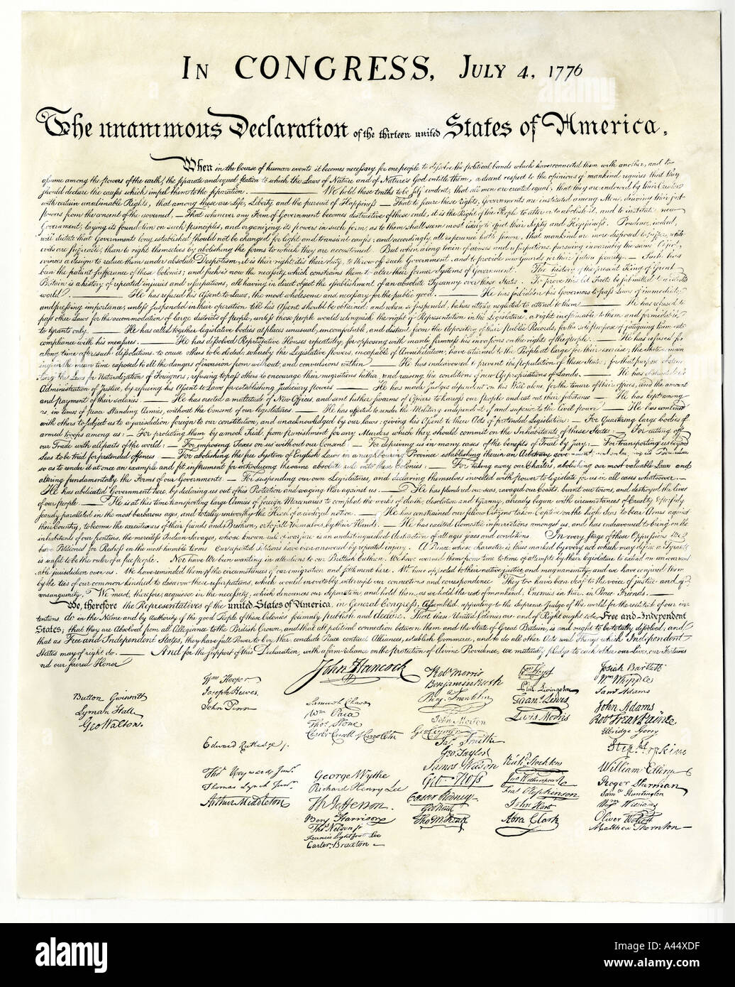

Slide 9
Signers of Declaration of Independence
John Adams - ``The Declaration was, in fact, an act of treason. ... Those who had signed it stood a good chance to incur the penalty meted out to traitors.'
John Adams and John Hancock were under sentence of death if captured by British
Francis Lewis wife was captured and imprisoned for 2 years and his home and farm destroyed and his 13 children were scattered
Richard Stockton was captured and thrown into prison and was repeatedly beaten and starved.
John Morris spent all his wealth of over a million dollars to help finance the war and died bankrupt serving 3 years in debtors’ prison.

Slide 10
Signers of Declaration of Independence
`Posterity. You will never know how much it cost the present generation to preserve your freedom. I hope you will make good use of it. 'The War of Independence already was under way when the founders gathered in Philadelphia to pledge ``our lives, our fortunes and our sacred honor' to gain liberty.
John Quincy Adams

Slide 11
Barzillai: Answered the Call
Answering the call in a time of need is a great them of the Bible
1 Kings 17:27-29 – Ahab’s servant Obadiah
Esther
Baruch
Barnabas
Greatest of all examples is Jesus

Slide 12
Barzillai: Answered the Call
Barzillai gave and expected nothing in return – (2 Sam. 19:31-37)
Barzillai rejected David’s honor
Sought honor for his servant
Luke 6:33-36
Jesus in every way epitomizes the example of sacrifice and compassion to those in need
Phil. 2

