Slide 1
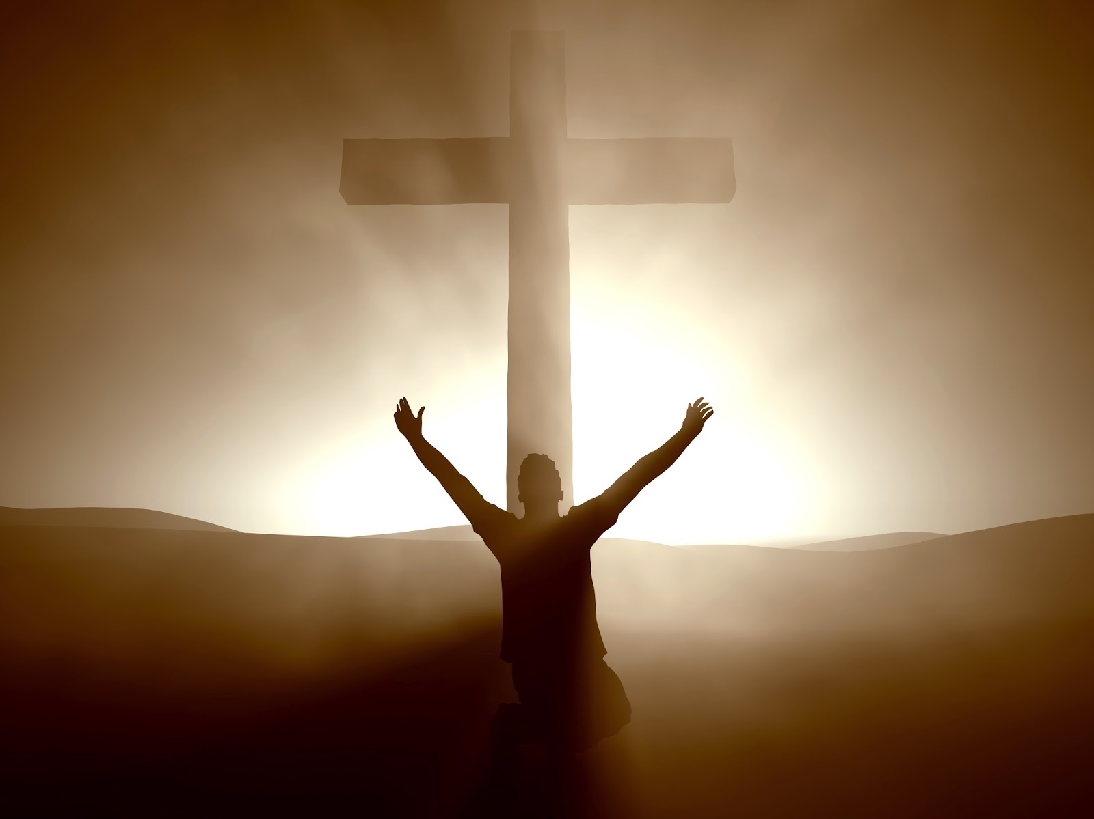
I’m Not Ashamed to Own My Lord

Slide 2
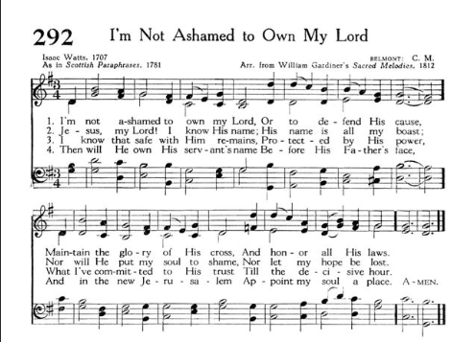
Jesus, my God! I know His name,
His name is all my trust;
Nor will He put my soul to shame,
Nor let my hope be lost

Slide 3
The Name

Slide 4
The Name
The Lord descended in the cloud and stood with him there, and proclaimed the name of the Lord. The Lord passed before him and proclaimed, “The Lord, the Lord, a God merciful and gracious, slow to anger, and abounding in steadfast love and faithfulness, keeping steadfast love for thousands, forgiving iniquity and transgression and sin, but who will by no means clear the guilty, visiting the iniquity of the fathers on the children and the children's children, to the third and the fourth generation.” – Exodus 34:5-7

Slide 5
The Name
Israel had a special relationship with God
Emissaries showing God to the nations
This gives better understanding to third command
And you shall be to me a kingdom of priests and a holy nation.’ These are the words that you shall speak to the people of Israel – Exodus 19:6

Slide 6
The Name
You shall not take the name of the Lord your God in vain, for the Lord will not hold him guiltless who takes his name in vain – Exodus 20:7
Respect in usage and in representation
Sadly, Israel failed, treating Him like a pagan god

Slide 7
Jesus: The Name Personified
And the crowds that went before him and that followed him were shouting, “Hosanna to the Son of David! Blessed is he who comes in the name of the Lord! Hosanna in the highest!” – Matthew 21:9
“Name of the Lord” found many times in Old Testament
New Testament focuses on the name of Jesus
And Peter said to them, “Repent and be baptized every one of you in the name of Jesus Christ for the forgiveness of your sins, and you will receive the gift of the Holy Spirit – Acts 2:38

Slide 8
Jesus: The Name Personified
Consider the parallels with Israel…
Christians are a kingdom of priests
Christians are emissaries – proclaiming His excellencies
Christians take His name to the nations
But you are a chosen race, a royal priesthood, a holy nation, a people for his own possession, that you may proclaim the excellencies of him who called you out of darkness into his marvelous light.
-- I Peter 2:9

Slide 9
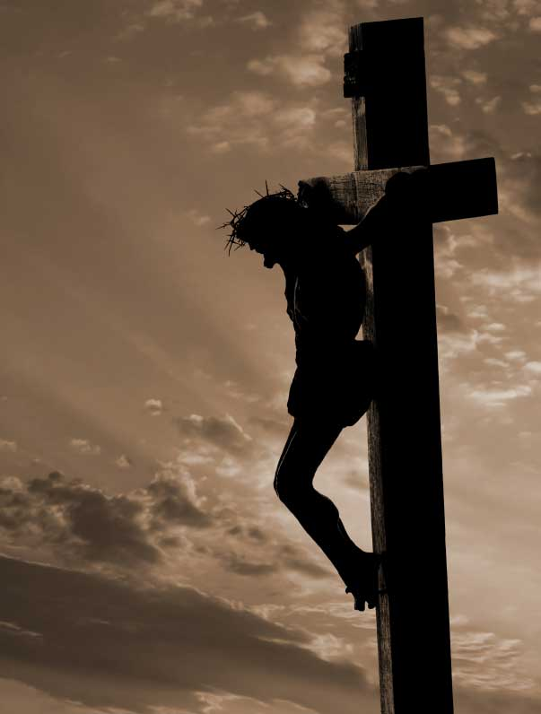
Ashamed or Unashamed?

Slide 10
Ashamed or Unashamed?
Peter: A Case Study (Mark 8)
Peter gave full endorsement of belief (27-30)
Jesus explained what this meant (31-32a)
Peter rejected this explanation (32b)
Jesus gave a sound rebuke (33)

Slide 11
A Teaching Moment
And calling the crowd to him with his disciples, he said to them, “If anyone would come after me, let him deny himself and take up his cross and follow me. For whoever would save his life will lose it, but whoever loses his life for my sake and the gospel's will save it. For what does it profit a man to gain the whole world and forfeit his soul? For what can a man give in return for his soul? For whoever is ashamed of me and of my words in this adulterous and sinful generation, of him will the Son of Man also be ashamed when he comes in the glory of his Father with the holy angels (34-38)

Slide 12
A Teaching Moment
And calling the crowd to him with his disciples, he said to them, “If anyone would come after me, let him deny himself and take up his cross and follow me. For whoever would save his life will lose it, but whoever loses his life for my sake and the gospel's will save it. For what does it profit a man to gain the whole world and forfeit his soul? For what can a man give in return for his soul? For whoever is ashamed of me and of my words in this adulterous and sinful generation, of him will the Son of Man also be ashamed when he comes in the glory of his Father with the holy angels (34-38)

Slide 13
Ashamed or Unashamed?
What would cause one to be ashamed of Jesus?
Appearance that His people are weak and abused
Therefore do not be ashamed of the testimony about our Lord, nor of me his prisoner, but share in suffering for the gospel by the power of God,/ Which is why I suffer as I do. But I am not ashamed, for I know whom I have believed, and I am convinced that he is able to guard until that day what has been entrusted to me/Yet if anyone suffers as a Christian, let him not be ashamed, but let him glorify God in that name – II Timothy 1:8,12/I Peter 4:16

Slide 14
Ashamed or Unashamed?
What would cause one to be ashamed of Jesus?
Appearance that His people are weak and abused
Jesus’ teachings divide right from wrong
Do your best to present yourself to God as one approved, a worker who has no need to be ashamed, rightly handling the word of truth – II Timothy 2:15

Slide 15
Ashamed or Unashamed?
What would cause one to be ashamed of Jesus?
Appearance that His people are weak and abused
Jesus’ teachings divide right from wrong
Belief in a Creator
Belief in Hell

Slide 16
Ashamed or Unashamed?
I Am Not Ashamed…
To own my Lord
“Admit or acknowledge one feels a certain way”
I own Him by wearing His name
I have been crucified with Christ. It is no longer I who live, but Christ who lives in me. And the life I now live in the flesh I live by faith in the Son of God, who loved me and gave himself for me. – Galatians 2:20

Slide 17
Ashamed or Unashamed?
I Am Not Ashamed…
To own my Lord
Nor to defend His cause
Embedded in owning the Lord
“If you love Me, keep My commandments”
“Keep” means to guard
Understand this is not my version of His commands
Willingness to take a stand in face of opposition
Willingness to help others find Jesus

Slide 18
Ashamed or Unashamed?
I Am Not Ashamed…
To own my Lord
Nor to defend His cause
Maintain the honor of His word
Maintain means to keep something as it should be
One struggle that Christians face is growing slack
Worldliness and wealth are spiritual killers!
As for what was sown among thorns, this is the one who hears the word, but the cares of the world and the deceitfulness of riches choke the word, and it proves unfruitful. – Matthew 13:22

Slide 19
From Now Through Eternity

Slide 20
From Now Through Eternity
Owning Christ Means He Willingly Owns Me
Now
Not ashamed to call us brethren (Hebrews 2:11)
Not ashamed to plead our cause daily (Hebrews 7:22f)
Eternity
What begins now will only grow better
The one who conquers, I will make him a pillar in the temple of my God. Never shall he go out of it, and I will write on him the name of my God, and the name of the city of my God, the new Jerusalem, which comes down from my God out of heaven, and my own new name – Revelation 3:12

Slide 21
Then will He own my worthless name
Before His Father’s face,
And in the new Jerusalem
Appoint my soul a place

