Slide 2
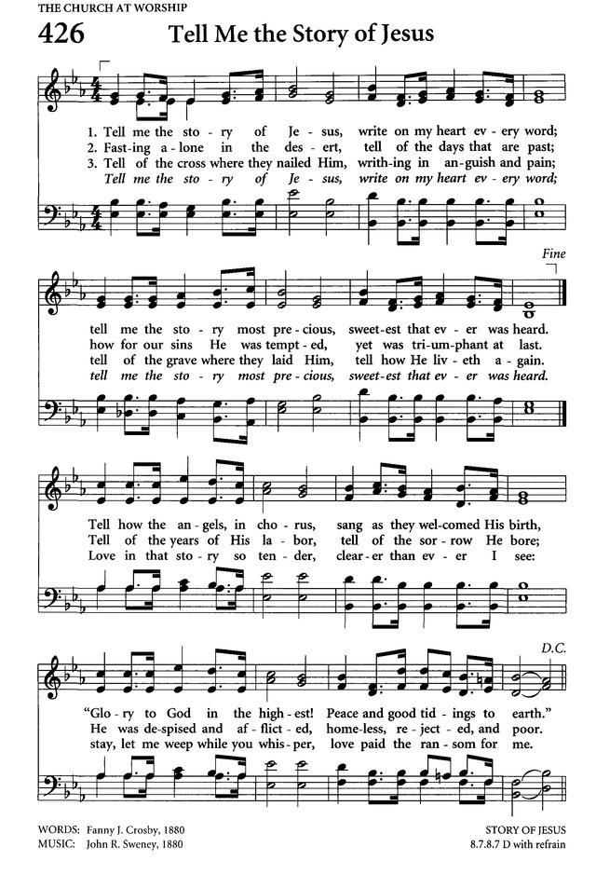

Slide 3
Tell me the stories of Jesus I love to hear;
Things I would ask Him to tell me
If He were here –
Scenes by the wayside,
Tales of the sea,
Stories of Jesus,
Tell them to me.

Slide 4
First let me hear how the children
Stood ’round His knee,
And I shall fancy His blessing
Resting on me;
Words full of kindness,
Deeds full of grace,
All in the love light
Of Jesus’ face.

Slide 5
Tell me, in accents of wonder,
How rolled the sea,
Tossing the boat in a tempest
On Galilee;
And how the Master,
Ready and kind,
Chided the billows
And hushed the wind.

Slide 6
Into the city I’d follow
The children’s band,
Waving a branch of the palm tree
High in my hand;
One of His heralds,
Yes, I would sing
Loudest hosannas –
Jesus is King!

Slide 7
Show me that scene in the garden,
Of bitter pain;
And of the cross where my Saviour
For me was slain;
Sad ones or bright ones,
So that they be
Stories of Jesus –
Tell them to me.

Slide 8
Who Needed to Hear the Story of Jesus?
Pentecost
Eunuch
Everyone

