Slide 2
MY EYES HAVE SEEN YOUR GLORY

Slide 3
Verse one:
I have seen you walk down a dusty road,
I have watched you stumble from my heavy load,
In my heart I struggled, but I always knew,
The Holy Redeemer from heaven was You.
Verse two:
I have seen You heal the lame, the blind
I have watched Your goodness, so pure, so kind;
In my heart I crumbled when I watched You die,
But now I rejoice for I know You’re alive.

Slide 4
Chorus:
My eyes have seen Your glory,
My hands have touched Your face,
My heart still burns within my breast,
From the warmth of Your embrace.
My eyes have seen Your glory,
My life forever changed;
And when this journey comes to an end,
I’ll rest in Your endless grace.

Slide 5
Did you see Jesus heal the lame/blind?
Did you watch Jesus die?
Did your hands touch Jesus’ face?
Did Jesus embrace you?

Slide 6
So, how then, do my eyes behold His glory?
FAITH

Slide 7
6 But without faith it is impossible to please Him, for he who comes to God must believe that He is, and that He is a rewarder of those who diligently seek Him.
Hebrews 11:6

Slide 8
For we walk by faith, not by sight
2 Cor. 5:7

Slide 9
Are you connected to…
Family?
Friends?
Church family?
Jesus?

Slide 10
1 That which was from the beginning, which we have heard, which we have seen with our eyes, which we have looked upon, and our hands have handled, concerning the Word of life-- 2 the life was manifested, and we have seen, and bear witness, and declare to you that eternal life which was with the Father and was manifested to us-- 3 that which we have seen and heard we declare to you, that you also may have fellowship with us; and truly our fellowship is with the Father and with His Son Jesus Christ. 4 And these things we write to you that your joy may be full.
1 John 1:1-4

Slide 11
1 That which was from the beginning, which we have heard, which we have seen with our eyes, which we have looked upon, and our hands have handled, concerning the Word of life-- 2 the life was manifested, and we have seen, and bear witness, and declare to you that eternal life which was with the Father and was manifested to us-- 3 that which we have seen and heard we declare to you, that you also may have fellowship with us; and truly our fellowship is with the Father and with His Son Jesus Christ. 4 And these things we write to you that your joy may be full.
1 John 1:1-4
Voluntary actions
Involuntary perceptions

Slide 12
1 That which was from the beginning, which we have heard, which we have seen with our eyes, which we have looked upon, and our hands have handled, concerning the Word of life-- 2 the life was manifested, and we have seen, and bear witness, and declare to you that eternal life which was with the Father and was manifested to us-- 3 that which we have seen and heard we declare to you, that you also may have fellowship with us; and truly our fellowship is with the Father and with His Son Jesus Christ. 4 And these things we write to you that your joy may be full.
1 John 1:1-4

Slide 13
Luke 24

Slide 14
1 That which was from the beginning, which we have heard, which we have seen with our eyes, which we have looked upon, and our hands have handled, concerning the Word of life-- 2 the life was manifested, and we have seen, and bear witness, and declare to you that eternal life which was with the Father and was manifested to us-- 3 that which we have seen and heard we declare to you, that you also may have fellowship with us; and truly our fellowship is with the Father and with His Son Jesus Christ. 4 And these things we write to you that your joy may be full.
1 John 1:1-4

Slide 15
14 And the Word became flesh and dwelt among us, and we beheld His glory, the glory as of the only begotten of the Father, full of grace and truth. 15 John bore witness of Him and cried out, saying, "This was He of whom I said, 'He who comes after me is preferred before me, for He was before me.'" 16 And of His fullness we have all received, and grace for grace. 17 For the law was given through Moses, but grace and truth came through Jesus Christ. 18 No one has seen God at any time. The only begotten Son, who is in the bosom of the Father, He has declared Him.
John 1:14-18

Slide 16
2 the life was manifested, and we have seen, and bear witness, and declare to you that eternal life which was with the Father and was manifested to us-- 3 that which we have seen and heard we declare to you, that you also may have fellowship with us; and truly our fellowship is with the Father and with His Son Jesus Christ.
1 John 1:2-3

Slide 17
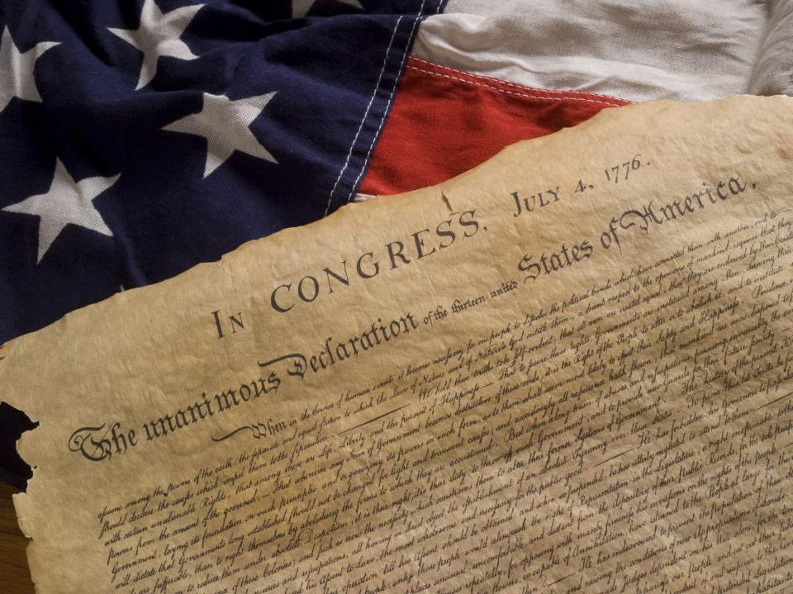

Slide 18
4 And these things we write to you that your joy may be full.
1 John 1:4

