Slide 1
EXPECTATION vs. REALITY
(Text Passage: Luke 7:24-29)

Slide 2
EXPECTATION vs. REALITY (Text: Luke 7:24-29)
Jesus discussed the difference between expectation and reality.
Of the times our Lord’s disciples had misconception about spiritual matters.
Text Passage: Luke 7:24-29. The disciples had preconceived ideas of John the Baptizer.
Notice misconception about rank order. (Mark 10:35-45)
Nicodemus and the “new birth.” (John 3:3-7)
The restoration of Kingdom to Israel. (Acts 1:6-8)
There are many other scriptures we could reference for this point.
Often our expectations are far different than reality.

Slide 3
EXPECTATION vs. REALITY (Text: Luke 7:24-29)
Some people expect to live forever, the reality is life is short.
Job knew his life was short. (Job 7:6-7)
James 4:14; “For what is your life? It is even a vapor that appears for a little time and then vanishes away.”
Job on the brevity of life. (Job 9:25-26)
Psalm 90:12; “So teach us to number our days, That we may gain a heart of wisdom.”
Even those who live to an older age have limited years. (Psalm 90:10)
Some think they have time to get ready for eternity.
Who told you such? Who told you how much time you have?

Slide 4
EXPECTATION vs. REALITY (Text: Luke 7:24-29)
Some people expect the Christian life to be simple, the reality is it is difficult.
“The Christian ideal has not been tried and found wanting. It has been found difficult; and left untried.” –G.K. Chesterton
Jesus gave the —Parable of the Sower (Luke 8:5-8; 11-14)
The Christian life is hard. We must avoid temptations, we must not entangle ourselves with the world, we must let our lights shine, we must do our duties….and it goes on and on. Do you ever feel overwhelmed?
One great key: God only expects me to do what I can today! (Heb. 3:7-13; 4:7)
We will suffer persecution as a Christian. (2 Tim. 3:12)
People may speak evil of you. (1 Pet. 3:15-17)
Those who overcome will sit with the Lord in glory. (Rev. 3:20-22)

Slide 5
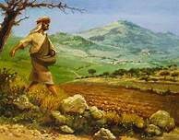
PARABLE OF THE SOWER (Text: Luke 8:5-8; 11-14)

Slide 6
EXPECTATION vs. REALITY (Text: Luke 7:24-29)
Some people never expect a judgment, the reality is we will all face it.
Judgment is a reality—even if you deny it!
Heb. 9:27 “And as it is appointed for men to die once, but after this the judgment.”
2 Cor. 5:10; “For we all must appear before the judgment seat of Christ, that each one receive the things done in the body, according to what he has done, whether good or bad.”
Judgment begins at the house of God. (1 Pet. 4:17-18)
The final judgment is a righteous one. (Rom. 2:2, 5)
Secrets of men will be judged. (Rom. 2:16)

Slide 7
EXPECTATION vs. REALITY (Text: Luke 7:24-29)
Some people expect heaven on earth, the reality is heaven is a real place with God.
This earth and it’s works will be destroyed. (2 Peter 3:10-13)
1 Cor. 15:19; “If in this life only we have hope in Christ, we are of all men the most pitiable.”
Christians look with expectation to heaven. (Heb. 10:34)
“Sing to me of heaven! Let me fondly dream!— “Oh that will be glory for me!, Glory for me, Glory for me!
How marvelous will it be?” (Rev. 22:1-5)
God will be in heaven, Jesus will be there, the Holy Spirit. (Rev. 21:1-7)
There will be some who won’t be there. (Rev. 21:8; 2 Thess. 1:6-10)

Slide 8
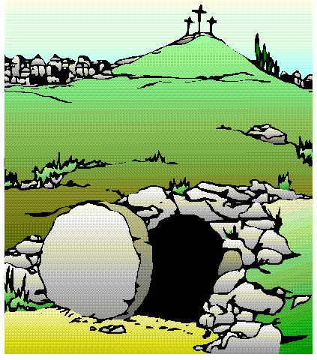
Jesus said; “Come unto me, all ye that labour and are heavy laden, and I will give you rest.”—Matt. 11:28
Hear the Gospel message—Rom. 10:17.
Believe in Jesus as God’s Son—
Heb. 11:6.
Repent of your sins— Acts 3:19.
Confess your faith in Jesus—Rom. 10:10.
Be baptized for the
remission of your sins—
Acts 2:38; Acts 22:16.
Live faithfully for God.
Heb. 10:23; Rev. 2:10.

