Slide 1
“Him Shall You Fear, Him Shall You Worship, & To Him You Shall Offer Sacrifice.”
2 Kings 17:36

Slide 2
“Him you shall fear…”
“Then the churches throughout all Judea, Galilee, and Samaria had peace and were edified. And walking in the fear of the Lord and in the comfort of the Holy Spirit, they were multiplied.”
-Acts 9:31

Slide 3
Defining Key Terms
“Yir’ah” (Hebrew) – Used in Old Testament
A) fear / terror
B) awesome or terrifying thing
C) reverence, respect, piety
“Phobos” (Greek) – Used in New Testament
A) fear, dread, terror
B) that which strikes terror
C) reverence

Slide 4
Defining Key Terms
“Tromos” (Greek) = Trembling
A) quaking with terror

Slide 5
“Him you shall fear…”
“Therefore, my beloved, as you have always obeyed, not as in my presence only, but now much more in my absence, work out your own salvation with fear and trembling.”
-Philippians 2:12

Slide 6
“Him you shall fear…”
“And do not fear those who kill the body but cannot kill the soul. But rather fear Him who is able to destroy both soul and body in hell.”
-Matt. 10:28

Slide 7
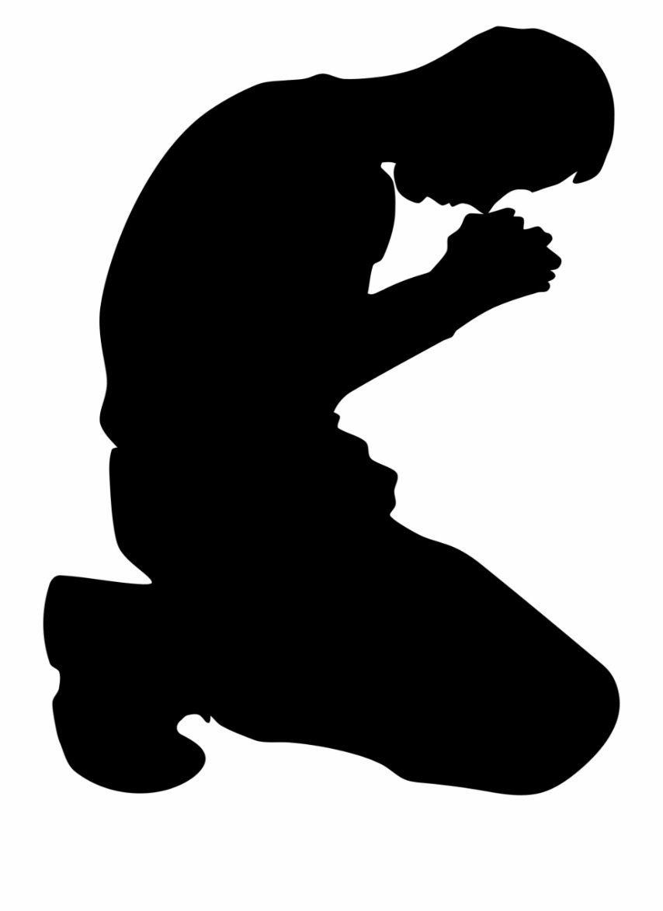
A Proper Fear of the Lord Would Include:
Reverence
Awe
Trembling

Slide 8
“Him you shall fear…” - from Proverbs
Prov. 1:7
“The fear of the Lord is the beginning of knowledge, But fools despise wisdom and instruction.”

Slide 9
“Him you shall fear…” - from Proverbs
Prov. 8:13
“The fear of the Lord is to hate evil; Pride and arrogance and the evil way And the perverse mouth I hate.”

Slide 10
“Him you shall fear…” - from Proverbs
Prov. 10:27
“The fear of the Lord prolongs days, But the years of the wicked will be shortened.”

Slide 11
“Him you shall fear…” - from Proverbs
Prov. 14:26
“In the fear of the Lord there is strong confidence, and His children will have a place of refuge.”

Slide 12
“Him you shall fear…” - from Proverbs
Prov. 16:6
“In mercy and truth
Atonement is provided for iniquity;
And by the fear of the Lord one departs from evil.”

Slide 13
“Him you shall fear…” - from Proverbs
Prov. 19:23 & 22:4
“The fear of the Lord leads to life..”
“By humility and the fear of the Lord are riches and honor and life.”

Slide 14
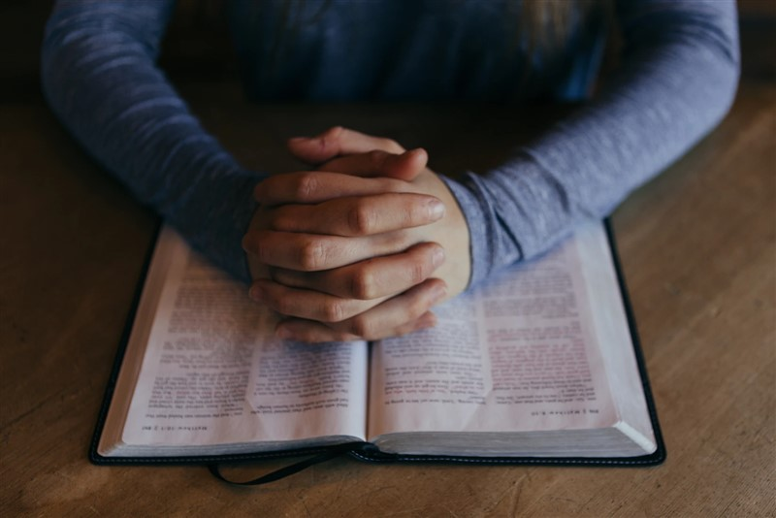
How Do We Develop?
Through God’s Word (Deut. 31:10-13)
ALL of God’s Word

Slide 15
“God is greatly to be feared in the assembly of the saints, And to be held in reverence by all those around Him.”
-Psalm 89:7

