Slide 1
I will call upon the Lord
Supplement #110

Slide 2
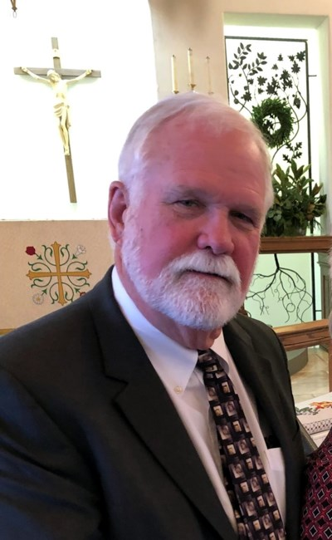
Michael Lee O’Shields

Slide 3
I will call upon the Lord
Luke 1:58-71 “Blessed be the Lord God of Israel, for he has visited and redeemed his people ⁶⁹ and has raised up a horn of salvation for us in the house of his servant David, ⁷⁰ as he spoke by the mouth of his holy prophets from of old, ⁷¹ that we should be saved from our enemies and from the hand of all who hate us

Slide 4
I will look upon the Lord
Psa. 27:13 I believe that I shall look upon the goodness of the LORD in the land of the living!
Job 19:25-27 For I know that my Redeemer lives,
and at the last he will stand upon the earth.
²⁶ And after my skin has been thus destroyed,
yet in my flesh I shall see God,
²⁷ whom I shall see for myself,
and my eyes shall behold, and not another.
My heart faints within me!

Slide 5
He is all my righteousness
Jer. 23:6 In his days Judah will be saved, and Israel will dwell securely. And this is the name by which he will be called: ‘The LORD is our righteousness.’

Slide 6
He is all my righteousness
Isa. 61:10 I will greatly rejoice in the LORD; my soul shall exult in my God, for he has clothed me with the garments of salvation; he has covered me with the robe of righteousness, as a bridegroom decks himself like a priest with a beautiful headdress, and as a bride adorns herself with her jewels.

Slide 7
He is all my righteousness
1 Cor. 1:28-31 God chose what is low and despised in the world, even things that are not, to bring to nothing things that are, ²⁹ so that no human being might boast in the presence of God. ³⁰ And because of him you are in Christ Jesus, who became to us wisdom from God, righteousness and sanctification and redemption, ³¹ so that, as it is written, “Let the one who boasts, boast in the Lord.”

Slide 8
He will make his face to shine on me
Num. 6:22-27 The LORD spoke to Moses, saying, ²³ “Speak to Aaron and his sons, saying, Thus you shall bless the people of Israel: you shall say to them, ²⁴ The LORD bless you and keep you; ²⁵ the LORD make his face to shine upon you and be gracious to you; ²⁶ the LORD lift up his countenance upon you and give you peace. ²⁷ “So shall they put my name upon the people of Israel, and I will bless them.”

Slide 9
He will make his face to shine on me
Psa. 31:14-17 But I trust in you, O LORD; I say, “You are my God.” ¹⁵ My times are in your hand; rescue me from the hand of my enemies and from my persecutors! ¹⁶ Make your face shine on your servant; save me in your steadfast love! ¹⁷ O LORD, let me not be put to shame, for I call upon you; let the wicked be put to shame; let them go silently to Sheol.

Slide 10
I will wait upon the Lord
Psa. 27:14 Wait for the LORD; be strong, and let your heart take courage; wait for the LORD!
Psa. 130:5-6 I wait for the LORD, my soul waits, and in his word I hope; ⁶ my soul waits for the Lord more than watchmen for the morning, more than watchmen for the morning.

Slide 11
He will fill me with new strength
Isa. 40:29-31 He gives power to the faint, and to him who has no might he increases strength. ³⁰ Even youths shall faint and be weary, and young men shall fall exhausted; ³¹ but they who wait for the LORD shall renew their strength; they shall mount up with wings like eagles; they shall run and not be weary; they shall walk and not faint.

Slide 12
The Lord lives!
Psa. 90:2 Before the mountains were brought forth, or ever you had formed the earth and the world, from everlasting to everlasting you are God.

Slide 13
I will call upon the Lord

