Slide 1
Traditions Are A Part of Every Culture
Birth
Life
Death
Some endure for long periods of time.

Slide 2
When One Dies
Lamentations and Weeping
A Burial Place
Preparation of the Body
Funeral and Procession

Slide 3
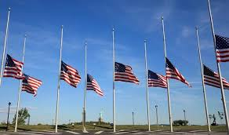
Flags At Half Staff

Slide 4
Funeral Procession
One Earliest Examples: Death of Jacob (Gen. 50)
In New Testament Times: (Luke 7)

Slide 5
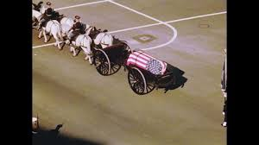
Funeral Processional

Slide 6
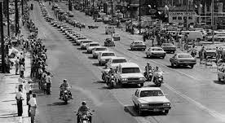
Funeral Processional

Slide 7
Some Customs Haven’t Survived Our Culture
The Destruction and Tearing of Clothing
We find many examples of people “tearing their robes” in the Bible.
Not always related to death, but more often than not it was.
Reuben tore his clothes when Joseph was missing (Gen. 37:29)
Mordecai when he learned of Haman’s plot to destroy the Jews (Esther 4:1)
Paul and Barnabas when the people of Lystra sought to worship them. (Acts 14:14)

Slide 8
Three Father’s Who Tore Their Clothes
Job (Job 1:18:20)
18 While he was still speaking, another also came and said, “Your sons and daughters were eating and drinking wine in their oldest brother’s house, 19 and suddenly a great wind came from [o]across the wilderness and struck the four corners of the house, and it fell on the young people, and they are dead; and I alone have escaped to tell you!”
20 Then Job arose, tore his robe, and shaved his head; and he fell to the ground and worshiped.

Slide 9
Three Father’s Who Tore Their Clothes
Jacob (Gen. 37:34)
31 So they took Joseph’s tunic, killed a kid of the goats, and dipped the tunic in the blood. 32 Then they sent the tunic of many colors, and they brought it to their father and said, “We have found this. Do you know whether it is your son’s tunic or not?”
33 And he recognized it and said, “It is my son’s tunic. A wild beast has devoured him. Without doubt Joseph is torn to pieces.” 34 Then Jacob tore his clothes, put sackcloth on his waist, and mourned for his son many days.

Slide 10
Three Father’s Who Tore Their Clothes
Jephthah (Judges 11:34-35)
34 When Jephthah came to his house at Mizpah, there was his daughter, coming out to meet him with timbrels and dancing; and she was his only child. Besides her he had neither son nor daughter.
35 And it came to pass, when he saw her, that he tore his clothes, and said, “Alas, my daughter! You have brought me very low! You are among those who trouble me! For I have given my word to the Lord, and I cannot go back on it.”

Slide 11
A Fourth Father Mourns His Child
Death of Jesus (Matt. 27:45-56)
So many unusual events surround our Lord’s death
veil of the Temple torn in two from top to bottom
the earth quaked
the rocks were split
the graves were opened
bodies were raised
Roman guards confessed, “Truly this was the Son of God!”

Slide 12
A Fourth Father Mourns His Son
The Veil of the Temple Torn In Two
The tearing of the veil had spiritual symbolism: the Most Holy Place was now open for all
But it may be a symbol of Father who is mourning the loss of His Son Jesus
As those fathers of old “tore their robes” in deep mourning for their loss, so God “tears this veil” perhaps as a symbol of His mourning

Slide 13
We All Have Some Mourning and Weeping To Do
Joel 2:12-13
12) “Now, therefore,” says the Lord,
“Turn to Me with all your heart,
With fasting, with weeping, and with mourning.”
13) So rend your heart, and not your garments;
Return to the Lord your God,
For He is gracious and merciful,
Slow to anger, and of great kindness;
And He relents from doing harm.

