Slide 1
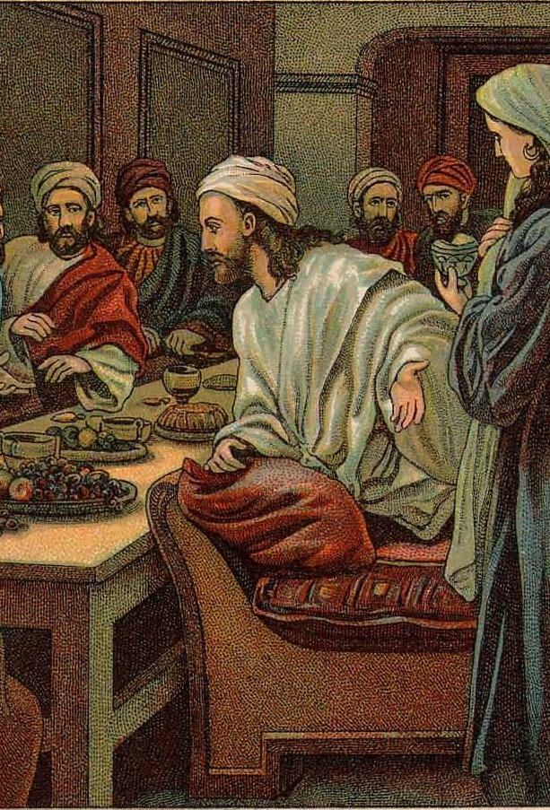
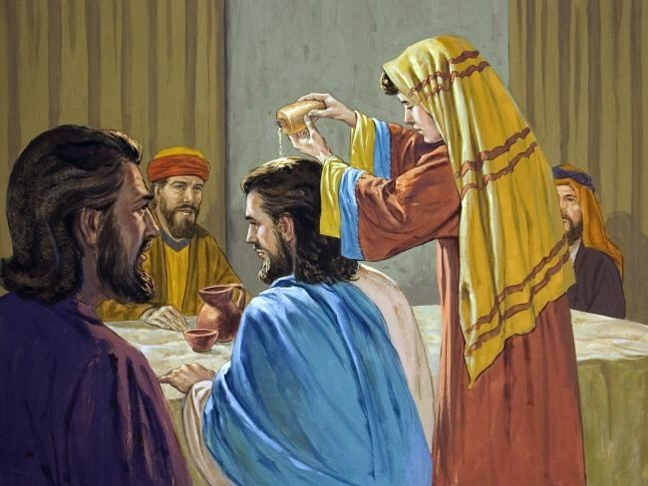
MATT. 26:6-13
The Anointing in Bethany

Slide 2
The ANSWER was right in front of the disciples.
“Why is she doing this?”

Slide 3
Grooming?
"Therefore, wash yourself and anoint yourself, put on your [best] garment and go down to the threshing floor; [but] do not make yourself known to the man until he has finished eating and drinking. [Ruth 3:3 NKJV]

Slide 4
Grooming?
"But you, when you fast, anoint your head and wash your face, [Mat 6:17 NKJV]

Slide 5
Medicinal?
"So he went to [him] and bandaged his wounds, pouring on oil and wine; and he set him on his own animal, brought him to an inn, and took care of him. [Luk 10:34 NKJV]

Slide 6
Ceremonial?
Then Samuel took the horn of oil and anointed him in the midst of his brothers; and the Spirit of the LORD came upon David from that day forward. So Samuel arose and went to Ramah. [1Sa 16:13 NKJV]

Slide 7
Ceremonial?
"You shall anoint them, as you anointed their father, that they may minister to Me as priests; for their anointing shall surely be an everlasting priesthood throughout their generations." [Exo 40:15 NKJV]

Slide 8
Ceremonial?
"Also you shall anoint Jehu the son of Nimshi [as] king over Israel. And Elisha the son of Shaphat of Abel Meholah you shall anoint [as] prophet in your place. [1Ki 19:16 NKJV]

Slide 9
Burial Tradition
Now when the Sabbath was past, Mary Magdalene, Mary [the mother] of James, and Salome bought spices, that they might come and anoint Him. [Mar 16:1 NKJV]

Slide 10
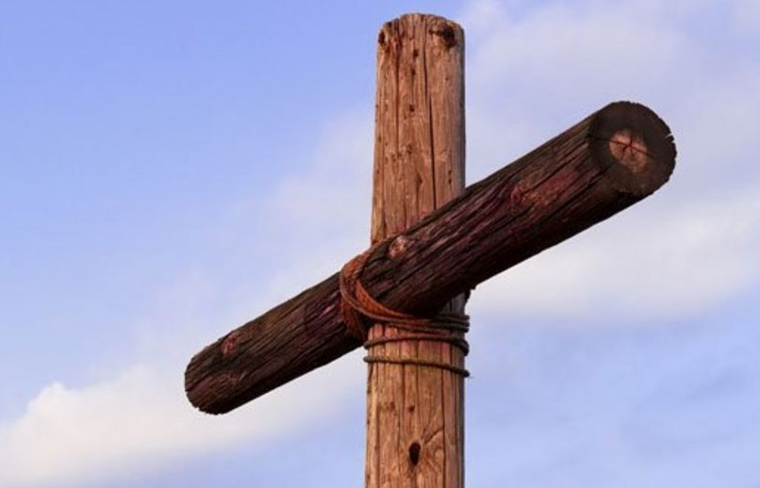
They Didn’t Understand..
Matt. 16: 21
Matt. 17:22-23
Matt. 20:17-19

Slide 11
They Didn’t Understand..
But they did not understand this saying, and were afraid to ask Him. [Mar 9:32 NKJV]

Slide 12
The ANSWERS were right in front of the disciples.
AND THEY ARE IN FRONT OF ME!

Slide 13
For we know in part and we prophesy in part. But when that which is perfect has come, then that which is in part will be done away. [1Co 13:9-10 NKJV]

Slide 14
This he said, not that he cared for the poor, but because he was a thief, and had the money box; and he used to take what was put in it.[John 12:6]

Slide 15
Mary’s Conviction That Jesus was The Lord..

Slide 16
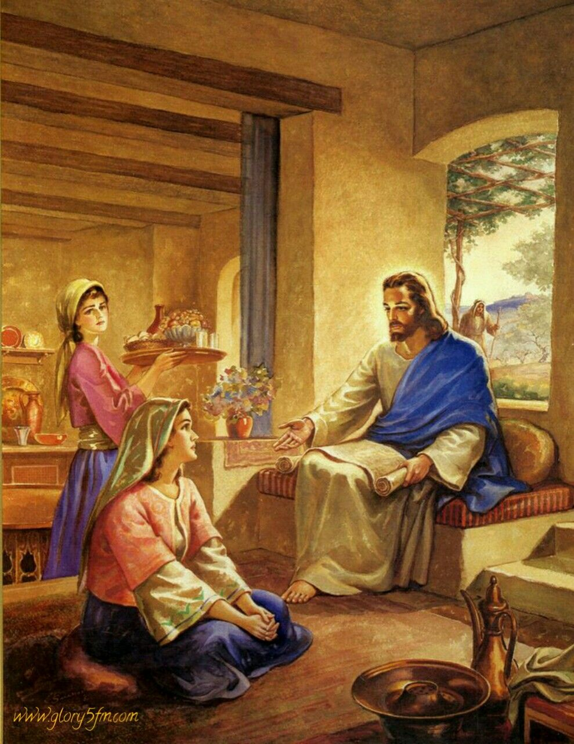
Luke 10:38-42
John 11:32

Slide 17
Where Do Your Convictions Lie?

Slide 18
Jesus’ Response ..
Gospel Is For The Entire World!
She Will Be Remembered

Slide 19
Likewise you younger people, submit yourselves to [your] elders. Yes, all of [you] be submissive to one another, and be clothed with humility, for "God resists the proud, But gives grace to the humble.” Therefore humble yourselves under the mighty hand of God, that He may exalt you in due time, casting all your care upon Him, for He cares for you. [1Pe 5:5-7]

Slide 20
We Have the Answers
Do We Have the Conviction?
He Will Exalt Us ..

