Slide 2
Saved
Saved
Putting the Pieces Together
Putting the Pieces Together

Slide 3
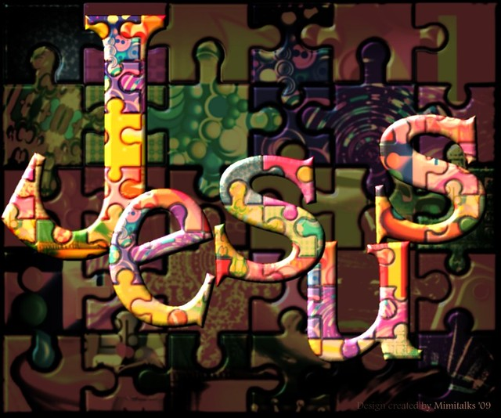
Jesus: “The Picture on the Box”

Slide 4
Jesus: The Picture on the Box
By His Own Words, Jesus Showed Himself Essential
Jesus said to him, “I am the way, and the truth, and the life. No one comes to the Father except through me – John 14:6
New Testament Writers Echo this Sentiment
The saying is trustworthy and deserving of full acceptance, that Christ Jesus came into the world to save sinners, of whom I am the foremost -- I Timothy 1:15
Since, therefore, we have now been justified by his blood, much more shall we be saved by him from the wrath of God. For if while we were enemies we were reconciled to God by the death of his Son, much more, now that we are reconciled, shall we be saved by his life. – Romans 5:9-10

Slide 5
There Is No Salvation Without Jesus!

Slide 6
Sorting the Pieces

Slide 7
The Undeserved Gift of Jesus Christ
For you know the grace of our Lord Jesus Christ, that though he was rich, yet for your sake he became poor, so that you by his poverty might become rich – II Corinthians 8:9
Grace
Even when we were dead in our trespasses, made us alive together with Christ—by grace you have been saved – Ephesians 2:5

Slide 8
Willingness of Jesus to Take My Place
Blessed be the God and Father of our Lord Jesus Christ! According to his great mercy, he has caused us to be born again to a living hope through the resurrection of Jesus Christ from the dead – I Peter 1:3
Mercy
He saved us, not because of works done by us in righteousness, but according to his own mercy, by the washing of regeneration and renewal of the Holy Spirit – Titus 3:5

Slide 9
Grace: Receiving an Undeserved Gift

Slide 10
Mercy: Not Receiving a Deserved Punishment

Slide 11
God Provides the Word
“Word” is important concept throughout the Bible
The Word explains plan of salvation
Word
For the word of the cross is folly to those who are perishing, but to us who are being saved it is the power of God – I Corinthians 1:18

Slide 12
Saved by Receiving the Word
Word is given opportunity to impact
More than reading, it is accepting the message
Receive
Therefore put away all filthiness and rampant wickedness and receive with meekness the implanted word, which is able to save your souls – James 1:21

Slide 13
Saved by Faith
Faith is belief in action
Faith
Because, if you confess with your mouth that Jesus is Lord and believe in your heart that God raised him from the dead, you will be saved. For with the heart one believes and is justified, and with the mouth one confesses and is saved – Romans 10:9-10
For by grace you have been saved through faith. And this is not your own doing; it is the gift of God – Ephesians 2:8

Slide 14
Saved by Calling on His Name
A cry for the Lord’s salvation
Strong Old Testament overtones
Call on His Name

Slide 15
II Samuel 6:2
Psalm 116:4
Psalm 116:13
Psalm 116:17
Call on the Name of the Lord
Lamentations 3:55
Zephaniah 3:9
Joel 2:32

Slide 16
Saved by Calling on His Name
A cry for the Lord’s salvation
Strong Old Testament overtones
Call on His Name
For “everyone who calls on the name of the Lord will be saved.” – Romans 10:13

Slide 17
Grace
Mercy
Call on His Name
Word
Faith
Call on
His Name
Receive

Slide 18
The Final Piece

Slide 19
Grace
Call on His Name
Mercy
Baptism
Faith
Word
Receive
Baptism, which corresponds to this, now saves you, not as a removal of dirt from the body but as an appeal to God for a good conscience, through the resurrection of Jesus Christ – I Peter 3:21

Slide 20
By no means! How can we who died to sin still live in it? Do you not know that all of us who have been baptized into Christ Jesus were baptized into his death? We know that our old self was crucified with him in order that the body of sin might be brought to nothing, so that we would no longer be enslaved to sin. – Romans 6:2-3, 6
But now that faith has come, we are no longer under a guardian, for in Christ Jesus you are all sons of God, through faith. For as many of you as were baptized into Christ have put on Christ. There is neither Jew nor Greek, there is neither slave nor free, there is no male and female, for you are all one in Christ Jesus. And if you are Christ's, then you are Abraham's offspring, heirs according to promise -- Galatians 3:25-29
Whoever believes and is baptized will be saved, but whoever does not believe will be condemned – Mark 16:16

Slide 21
I have been crucified with Christ. It is no longer I who live, but Christ who lives in me. And the life I now live in the flesh I live by faith in the Son of God, who loved me and gave himself for me – Galatians 2:20
Salvation

