Slide 2
King David’s First Big Test
A Study of I Chronicles 13-15

Slide 3
I Chronicles: “Hurry Up” Approach to Kingship
Anointed King: 11:1-3
Taking of Jerusalem: 11:4-9
Chronicling the “Mighty Men”: 11:10-12:40
Everything Now in Place to Display the King’s Test

Slide 4
2
Failure
Success
Seemingly Unrelated Accounts
14:1-17
13:1-14
15:1-16:43

Slide 5
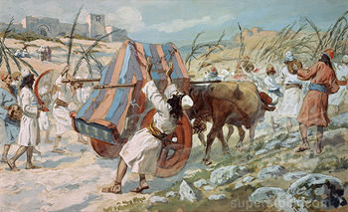
Failure
David’s “Great” Idea: Bring Ark to Jerusalem
Consulted leaders of Israel (1)
Great planning for the parade (2)
Contrasted with the “previous administration” (3)
“The Thing was Right in the Eyes of the People”

Slide 6
Failure
The Failed Plan
Parade began with great fanfare (5)

Slide 7
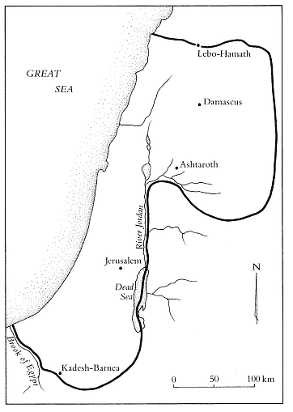

Slide 8
Failure
The Failed Plan
Parade began with great fanfare (5)
Ark sat on a new cart, tended by Uzzah and Ahio
After all, it is how the Philistines returned it years before
Uzzah killed for touching the ark (10)

Slide 9
Failure
Reaction of the King
Angry and afraid (11-12)
Named place: “Breaking out Against Uzzah” (11)
Ceased plan to “bring ark home to me”
Obed-edom blessed for showing the Lord hospitality

Slide 10
A Choice Had to be Made
Two Accounts Separate Story of Ark’s Return
Choice One: Powerful Monarch
Recognized by other monarchs
Head of exalted nation
Harem, with numerous sons

Slide 11
A Choice Had to be Made
Two Accounts Separate Story of Ark’s Return
Choice Two: Servant King
Trusting God to faithfully direct
Philistines proved no match for God
“Baal-perazim” – “God Breaking Through”

Slide 12
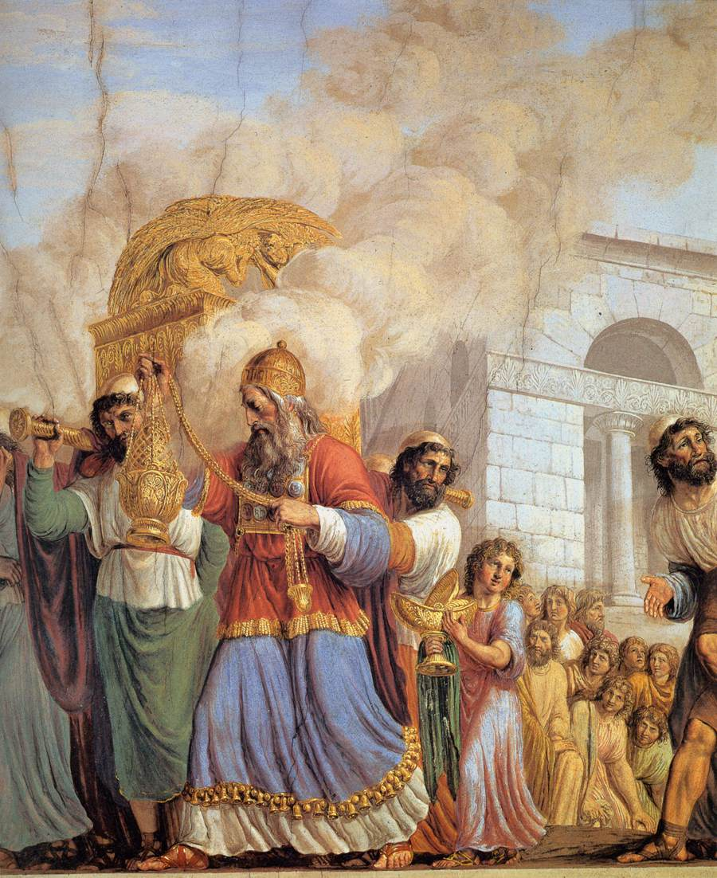
Success
Much more preparation in second attempt

Slide 13
Then David said that no one but the Levites may carry the ark of God, for the Lord had chosen them to carry the ark of the Lord and to minister to him forever. (15:2)
“You are the heads of the fathers' houses of the Levites. Consecrate yourselves, you and your brothers, so that you may bring up the ark of the Lord, the God of Israel, to the place that I have prepared for it. (15:12)
And the Levites carried the ark of God on their shoulders with the poles, as Moses had commanded according to the word of the Lord. (15:15)
And because God helped the Levites who were carrying the ark of the covenant of the Lord, they sacrificed seven bulls and seven rams. (15:26)

Slide 14
Success
Much more preparation in second attempt
David’s Conclusion: “Because you did not carry it the first time, the Lord our God broke out against us, because we did not seek him according to the rule” (13)

Slide 15
Success
Worship, Honor, Praise Given to the Lord
David penned song of thanks to the true King
Praises His power (31-34)
Praises His salvation (35-36)

Slide 16
When My Tests Come
Learning How to Establish Authority
It is not the appearance of “doing good”
It is not using another’s failure as inspiration
It is not large numbers of people agreeing

Slide 17
When My Tests Come
Learning How to Establish Authority
Authority always flows from God
If specified, it is doing exactly as He stated
If judgment, it is using principles He has given
Because you did not carry it the first time, the Lord our God broke out against us, because we did not seek him according to the rule

Slide 18
When My Tests Come
Am I “King” or “Servant”?
King, if I believe God should conform to my ideas
Genuine faith helps develop servant mentality
Trust that God will do what is right
One's pride will bring him low, but he who is lowly in spirit will obtain honor. – Proverbs 29:23

