Slide 2
How to be Good Soil

Slide 3
Hearing the Word

Slide 4
Hearing the Word
Biblically, hearing is not simply an auditory process
The call to hear means something important is being announced
And Moses summoned all Israel and said to them, “Hear, O Israel, the statutes and the rules that I speak in your hearing today, and you shall learn them and be careful to do them. – Deuteronomy 5:1

Slide 5
Hearing the Word
Most People Have “Hearing Problems”
Poor Communicator
Insufficient knowledge
Doesn’t gauge hearer(s)
Tired, distracted
Insufficient preparation
Apathetic to speaker/message

Slide 6
Hearing the Word
Because your heart was tender and you humbled yourself before God when you heard his words against this place and its inhabitants, and you have humbled yourself before me and have torn your clothes and wept before me, I also have heard you, declares the Lord. – II Chron. 34:27
Now when they heard this they were cut to the heart, and said to Peter and the rest of the apostles, “Brothers, what shall we do?” – Acts 2:37
Most People Have “Hearing Problems”
Both must see importance of message
Both speaker and hearer must be prepared
Both must be interested and engaged

Slide 7
Understanding the Word

Slide 8
Understanding the Word
Understanding: “Putting the pieces together”
Message is heard; application is determined
Meditation: the essential ingredient
Bible is designed to be pondered
One “muses” on personal studies, classes, sermons
This Book of the Law shall not depart from your mouth, but you shall meditate on it day and night, so that you may be careful to do according to all that is written in it. For then you will make your way prosperous, and then you will have good success. – Joshua 1:8

Slide 9
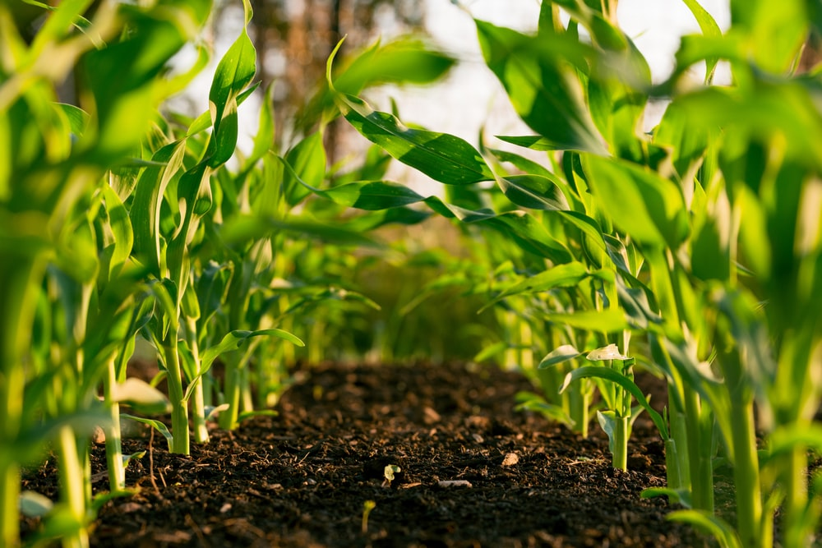
Good Soil: A Case Study
Colossians 1:3-10

Slide 10
Good Soil: A Case Study
Gospel’s impact seen in Colossae
They heard and understood (6b)
They learned from one who knew the gospel (7)
Hearing and understanding put to work (9)
“Spiritual wisdom” is the outcome

Slide 11
Him we proclaim, warning everyone and teaching everyone with all wisdom, that we may present everyone mature in Christ (1:28)
That their hearts may be encouraged, being knit together in love, to reach all the riches of full assurance of understanding and the knowledge of God's mystery, which is Christ, in whom are hidden all the treasures of wisdom and knowledge (2:2-3)
Let the word of Christ dwell in you richly, teaching and admonishing one another in all wisdom, singing psalms and hymns and spiritual songs, with thankfulness in your hearts to God. (3:16)
Walk in wisdom toward outsiders, making the best use of the time. (4:5)

Slide 12
Good Soil: A Case Study
Gospel’s impact seen in Colossae
They heard and understood (6b)
They learned from one who knew the gospel (7)
Hearing and understanding put to work (9)
“Spiritual wisdom” produces
A worthy walk
Appropriate work
Advancing levels of knowledge

Slide 13
Good Soil: A Case Study
Spiritual wisdom places responsibility on me
Bible is not a narrated guide through life or a rule book
Bible is a book to guide me into spiritual wisdom
Impacts my time: Meditation on word is essential
Impacts how I interpret the Bible
Impacts how I choose to live my life

Slide 14
Who is wise and understanding among you? By his good conduct let him show his works in the meekness of wisdom. – James 3:13
Not Wisdom
Bitter Jealousy
Selfish Ambition
Boastful
False to the Truth
Disorder
Vile Practices
Wisdom from Above
Pure
Peaceable
Gentle
Open to Reason
Full of Mercy/Good Fruits
Impartial
Sincere
Earthly
Unspiritual
Harvest of Righteousness
Demonic

Slide 15
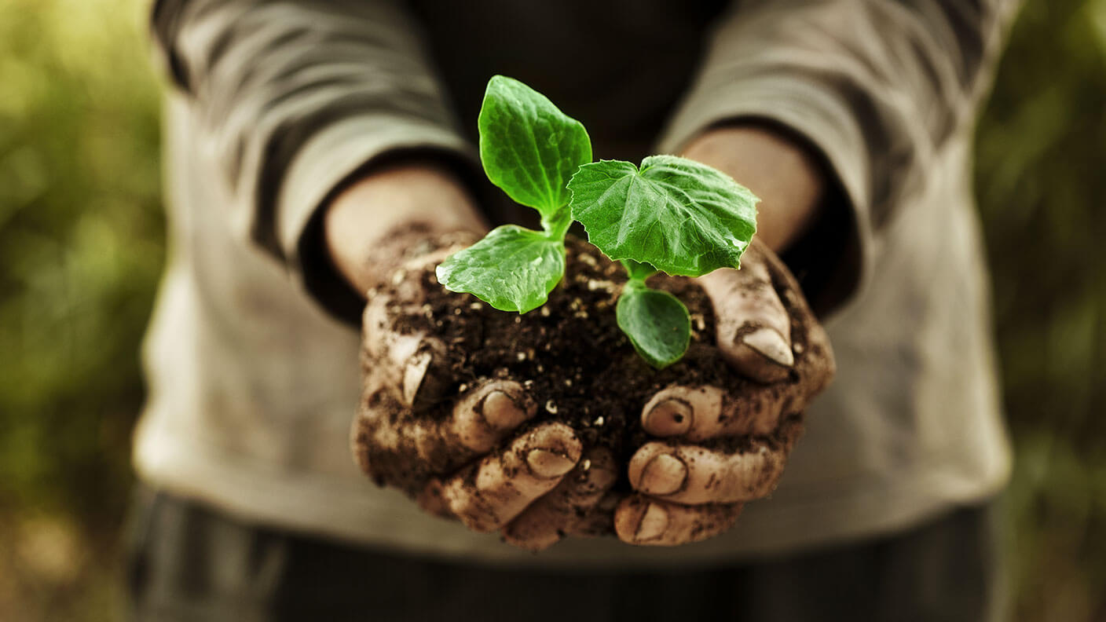
What Does Your Soil Test Reveal?

