Slide 1
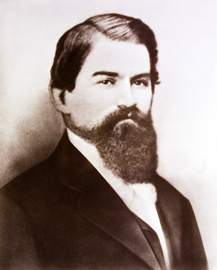
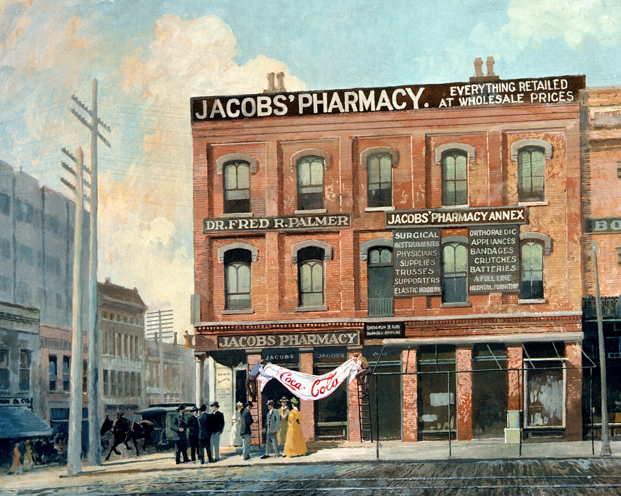
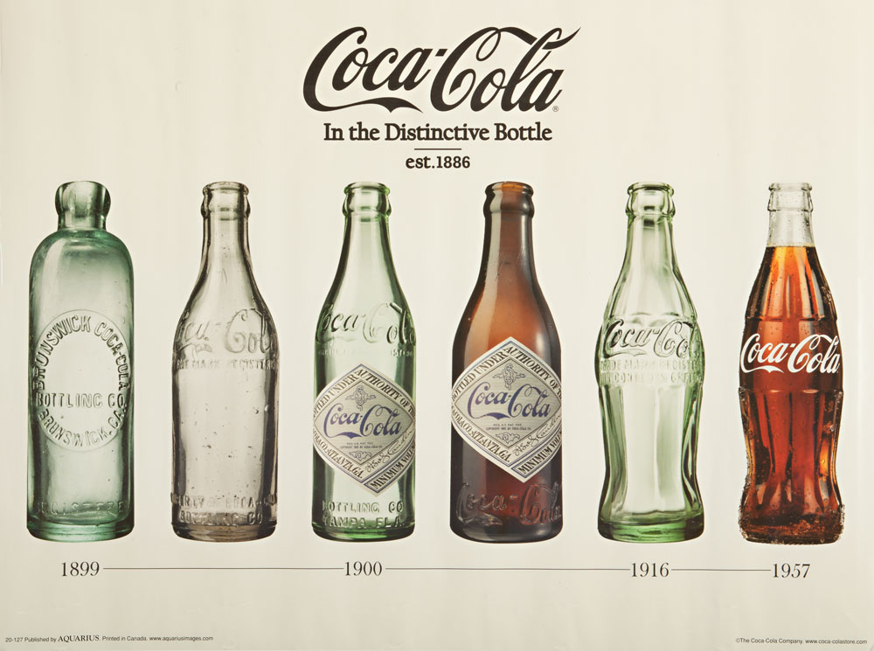

Slide 2
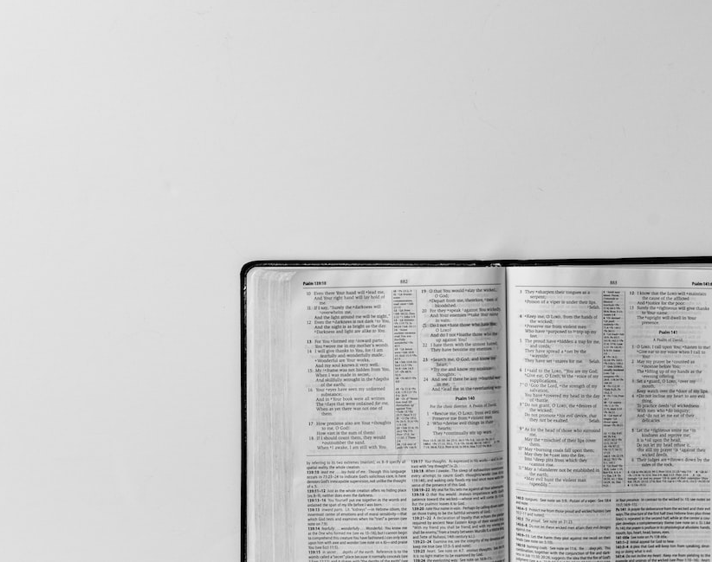
God-Fearing Cornelius
Acts 10

Slide 3
Cornelius’ Character (Ac. 10:1-4)
Devout
God-fearing
Taught his household
Generous
Prayerful
Great reputation
Cornelius’ Conversion (Ac. 10:24ff)

