Slide 1
The godly test
1 John 4:1

Slide 2
1 John 4:1 -- “test the spirits to see whether they are from God…”
1 Thess. 5:21 – “Test all things, hold fast to what is good.”
Job 12:11 – “Does not the ear test words…”

Slide 3
“Take up the bible, compare the religion of the latter-day saints with it, and see if it will stand the test.”
Brigham Young – 2nd ”prophet” of the Latter-Day saints

Slide 4
Does the Bible Stand the test?

Slide 5
Evidence #1 - The Content of the bible
66 Books Compiled into One Volume
40+ Writers
Written Over a Period of 1,500 Years
NOT A SINGLE DOCTRINAL CONTRADICTION!

Slide 6
Homer = 95% Accurate
NT = 99.95% Accurate

Slide 7
Evidence #2 – the writers
Credible or Fraud?
Fame? Stephen in Acts 7 / James - 12:2-3
Power?
Money? 1 Tim. 1:3-12 / 2 Cor. 11:23-27

Slide 8
Evidence #2 – the writers
“Whether it is right in the sight of God to give heed to you rather than to God, you be the judge; for we cannot stop speaking about what we have seen and heard.”
Acts 4:19-20

Slide 9
Evidence #3 - Prophecy
Deut. 18:21-22
“You may say in your heart, ‘How will we know the word which the LORD has not spoken?’ When a prophet speaks in the name of the LORD, if the thing does not come about or come true, that is the thing which the LORD has not spoken. The prophet has spoken it presumptuously; you shall not be afraid of him.”

Slide 10
Evidence #3 - Prophecy
Prophesies from God:
Are Specific in Detail
&
Come to Pass

Slide 11
Evidence #3 - Prophecy
Prophecies About Jesus:
Micah 5:2 – born in Bethlehem
Is. 9:1-2 – preach in Galilee
Is. 53:3, 5, 12 – rejected, wounded, and numbered with thieves
Zechariah 11:12 – betrayed for 30 pieces of silver

Slide 12
Evidence #3 - Prophecy
Prophecies About Jesus:
Psalm 22:16 & 18 – hands/feet would be pierced & lots cast for His garments
Psalm 16:10 – He would rise from the dead

Slide 13
Evidence #3 - Prophecy
Prophecies About Jesus:
Over 330 prophecies fulfilled by Jesus
Mathematical probability?
84x10¹²³

Slide 14
84x10¹²³
84,000,000,000,000,000,000,000,000,000,000,000,000,000,000,000,000,000,000,000,000,000,000,000,000,000,000,000,000,000,000,000,000,000,000,000,000,000,000,000,000,000

Slide 15
Evidence #3 - Prophecy
“Only a divine mind could have conceived such a character through the centuries, recording these things about Him; and only a Divine person could have fulfilled the predictions.”
Ferrell Jenkins

Slide 16
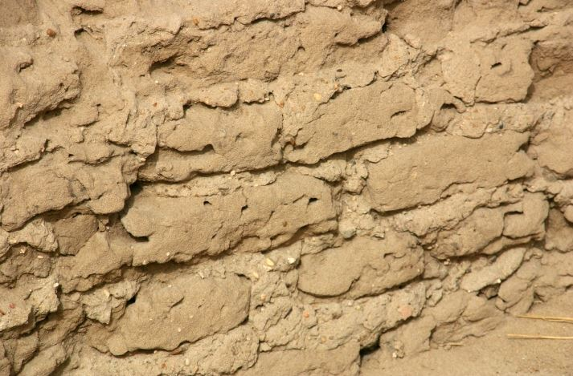
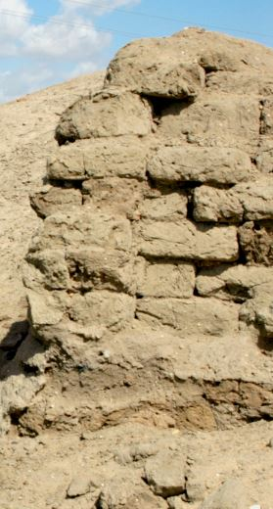
Evidence #4 - archaeology
Exodus 1:11 & 5:6-19

Slide 17
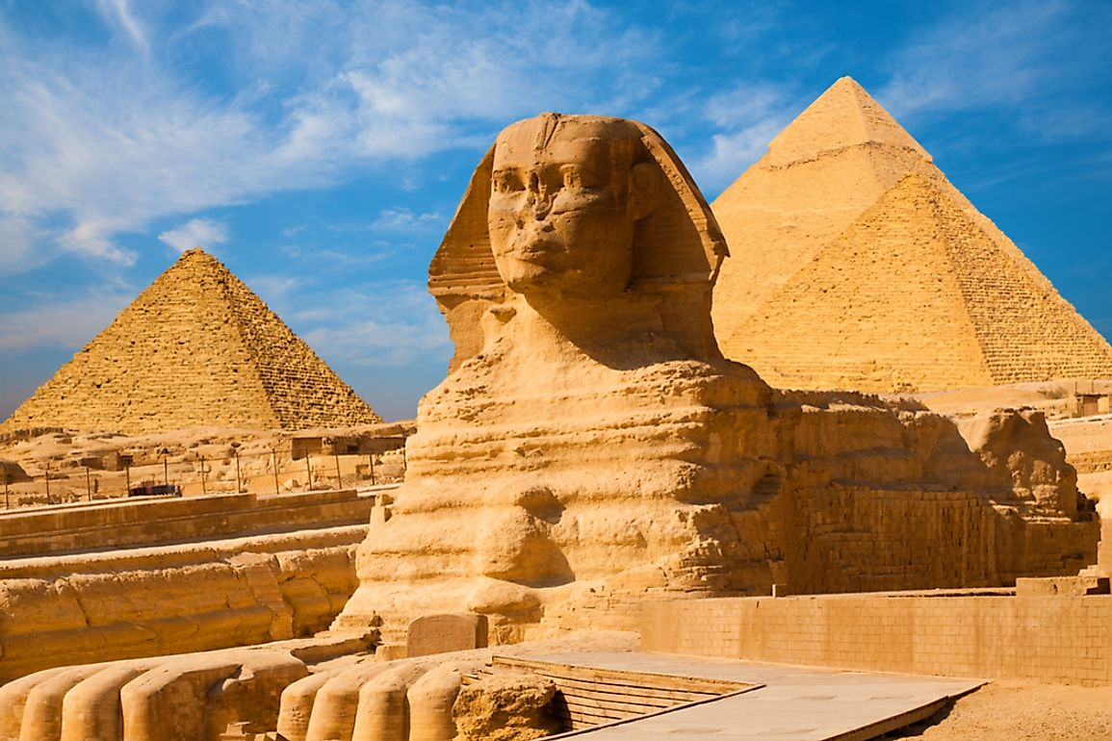
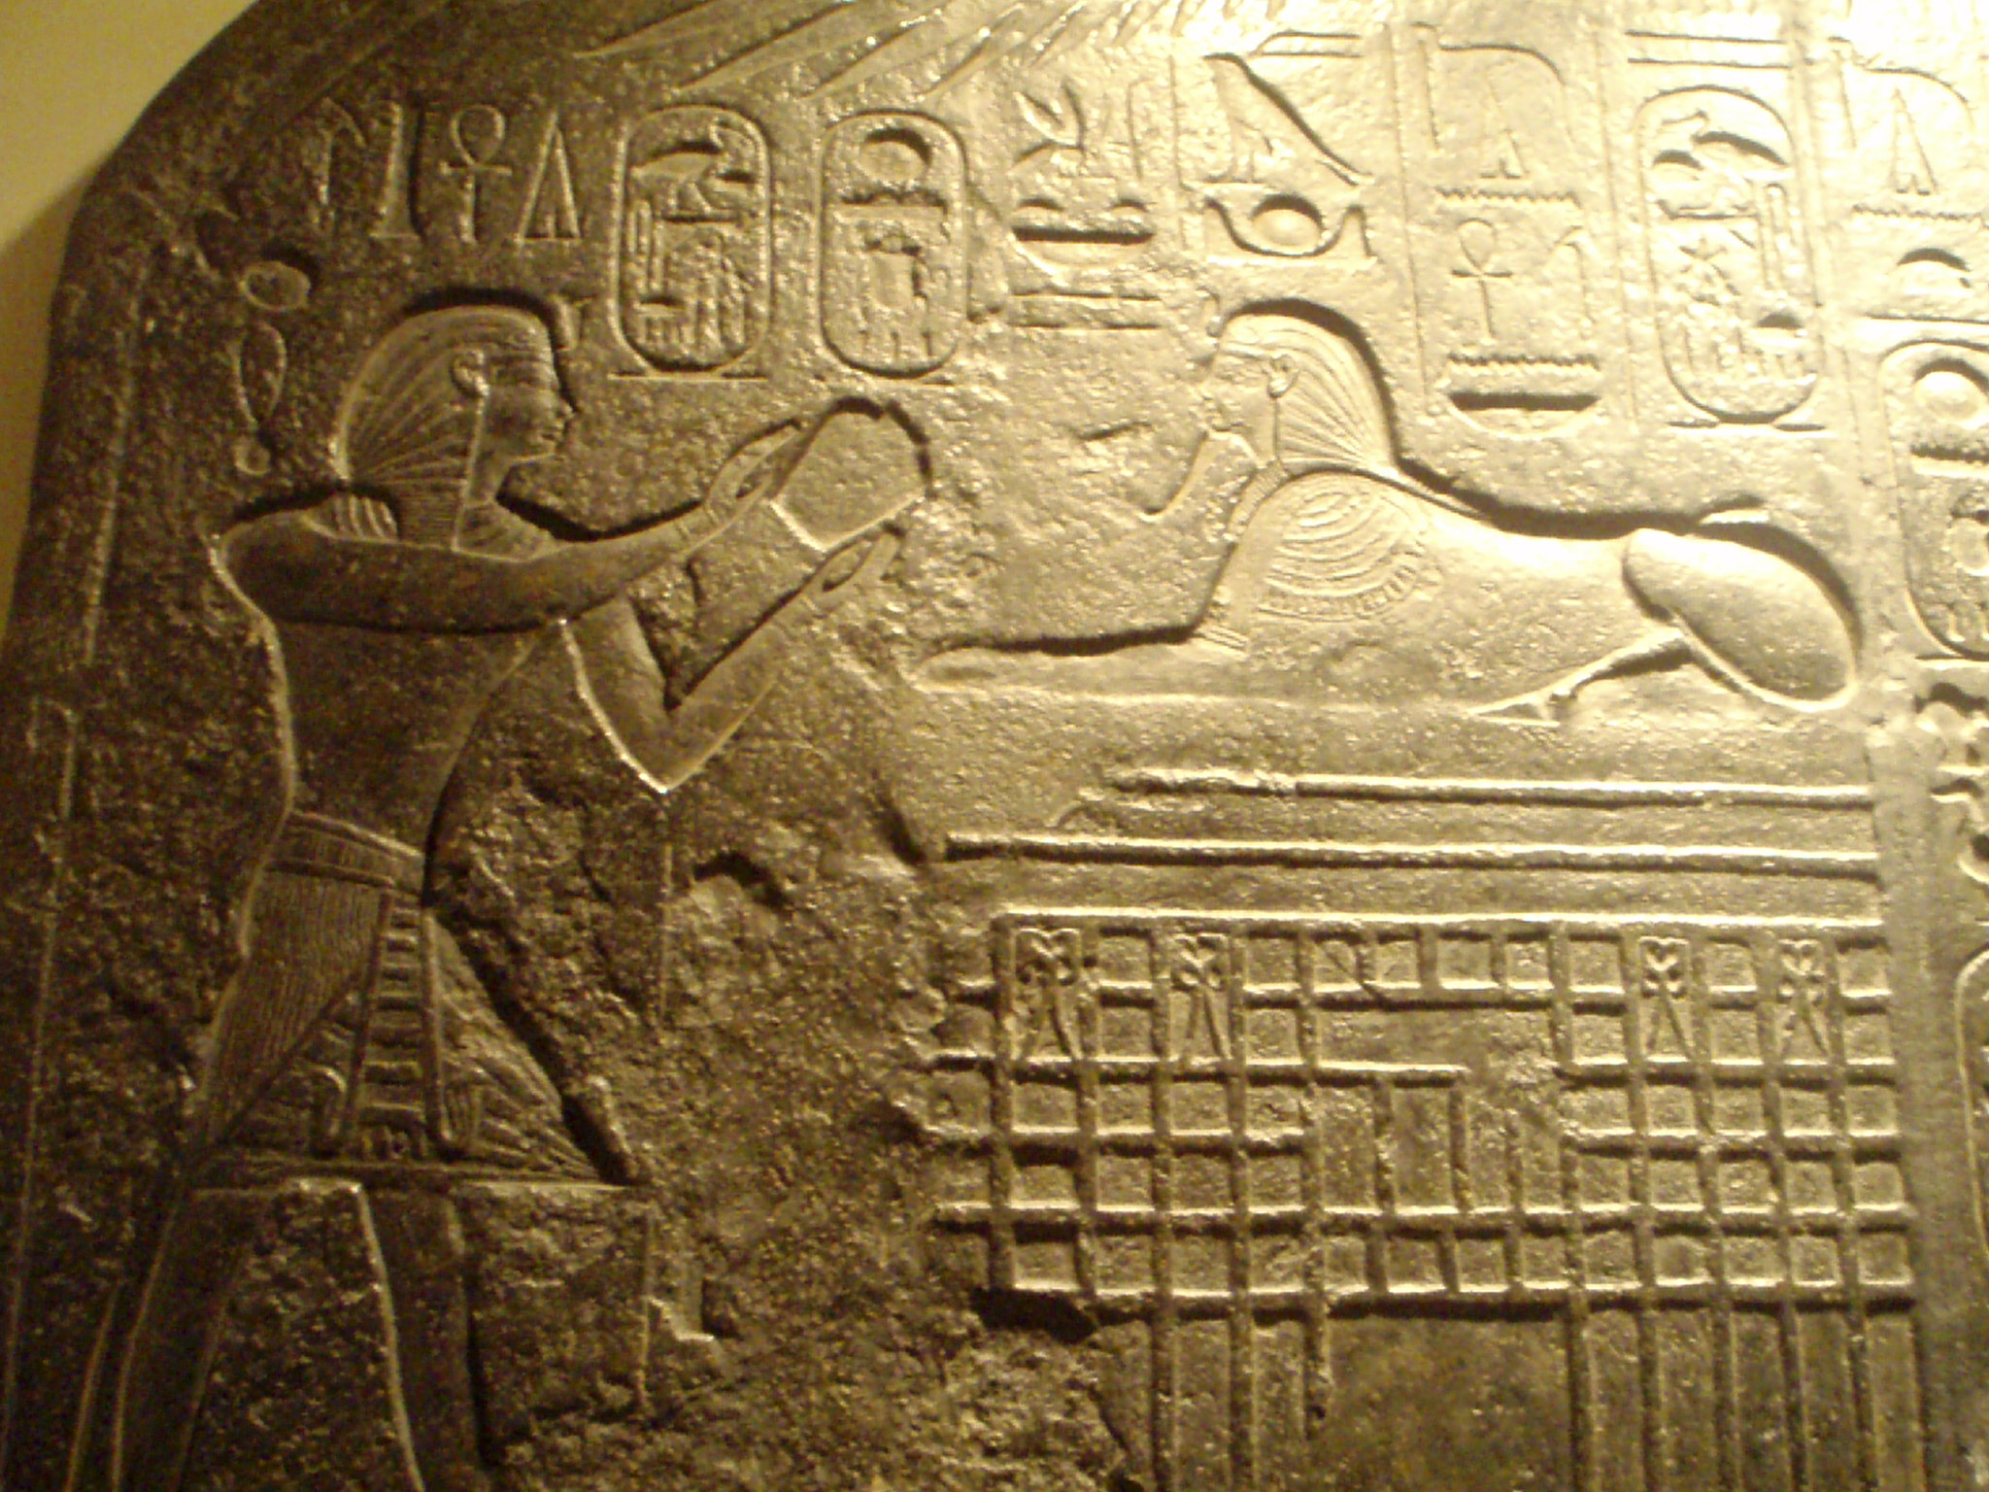
Evidence #4 - archaeology
Exodus 12:29

Slide 18
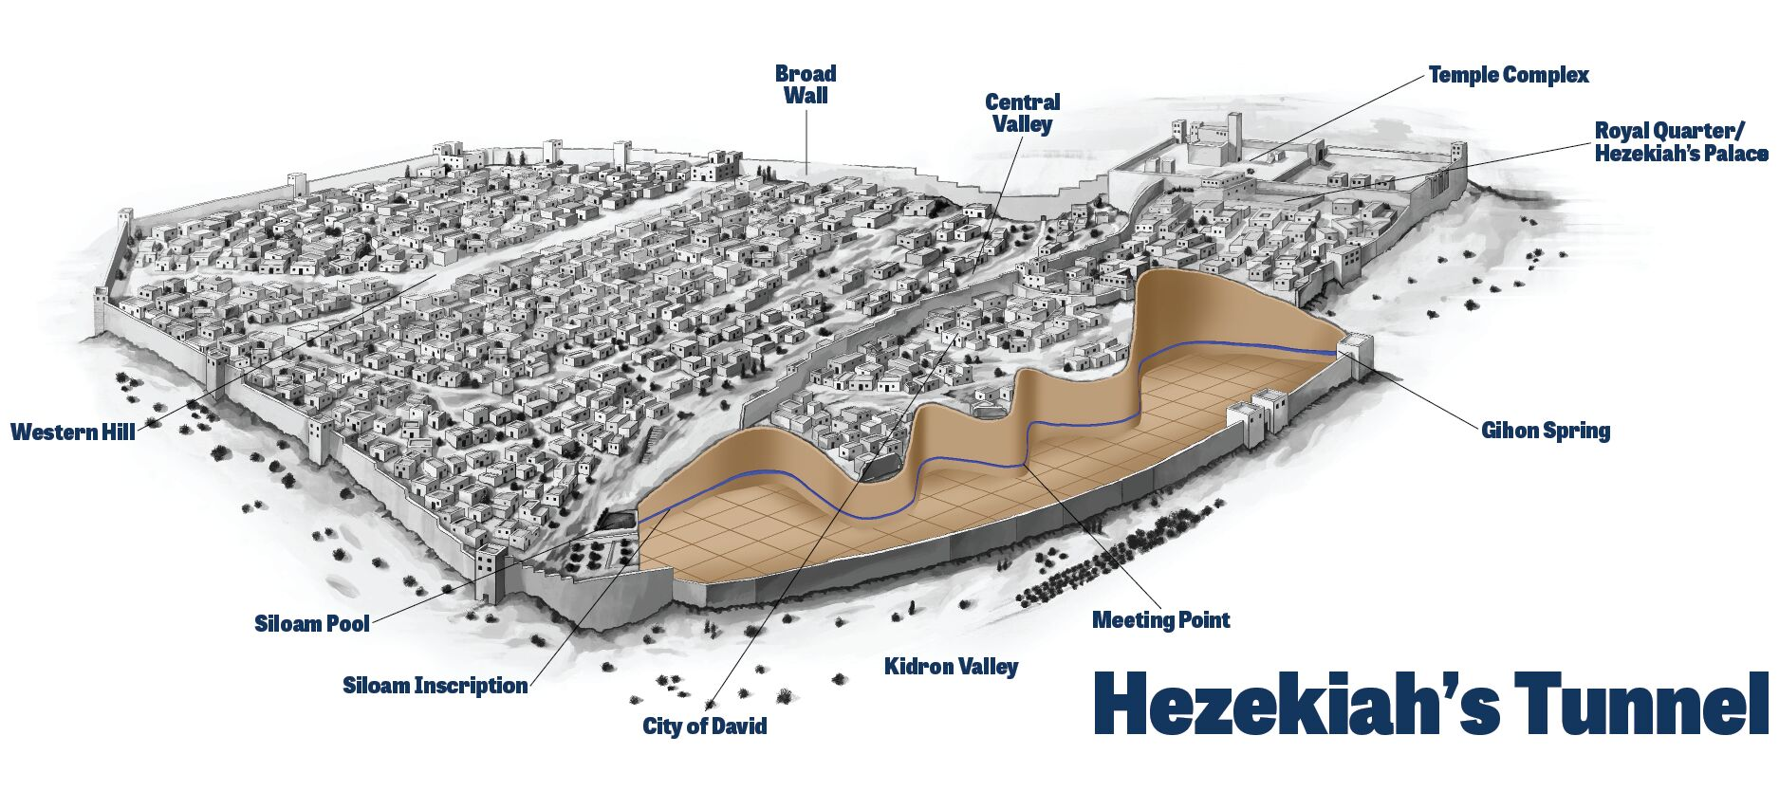
Evidence #4 - archaeology
2 Kings 20:20 / 2 Chron. 32:2-3, 30

Slide 19
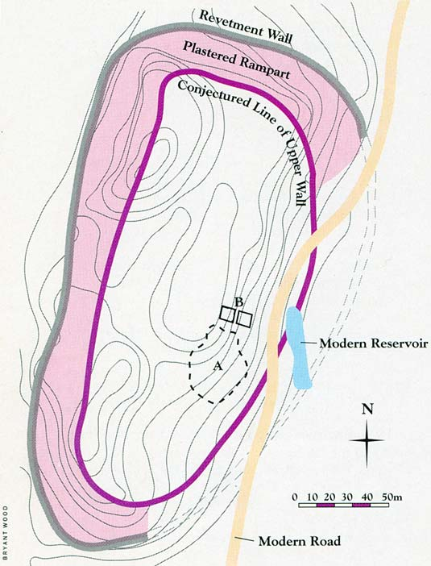
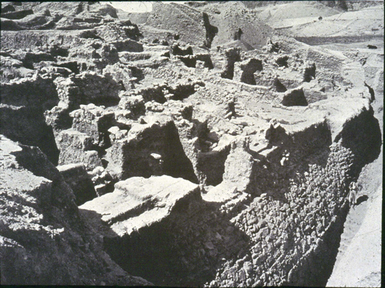
Evidence #4 - archaeology
Joshua 2 & 6

Slide 20
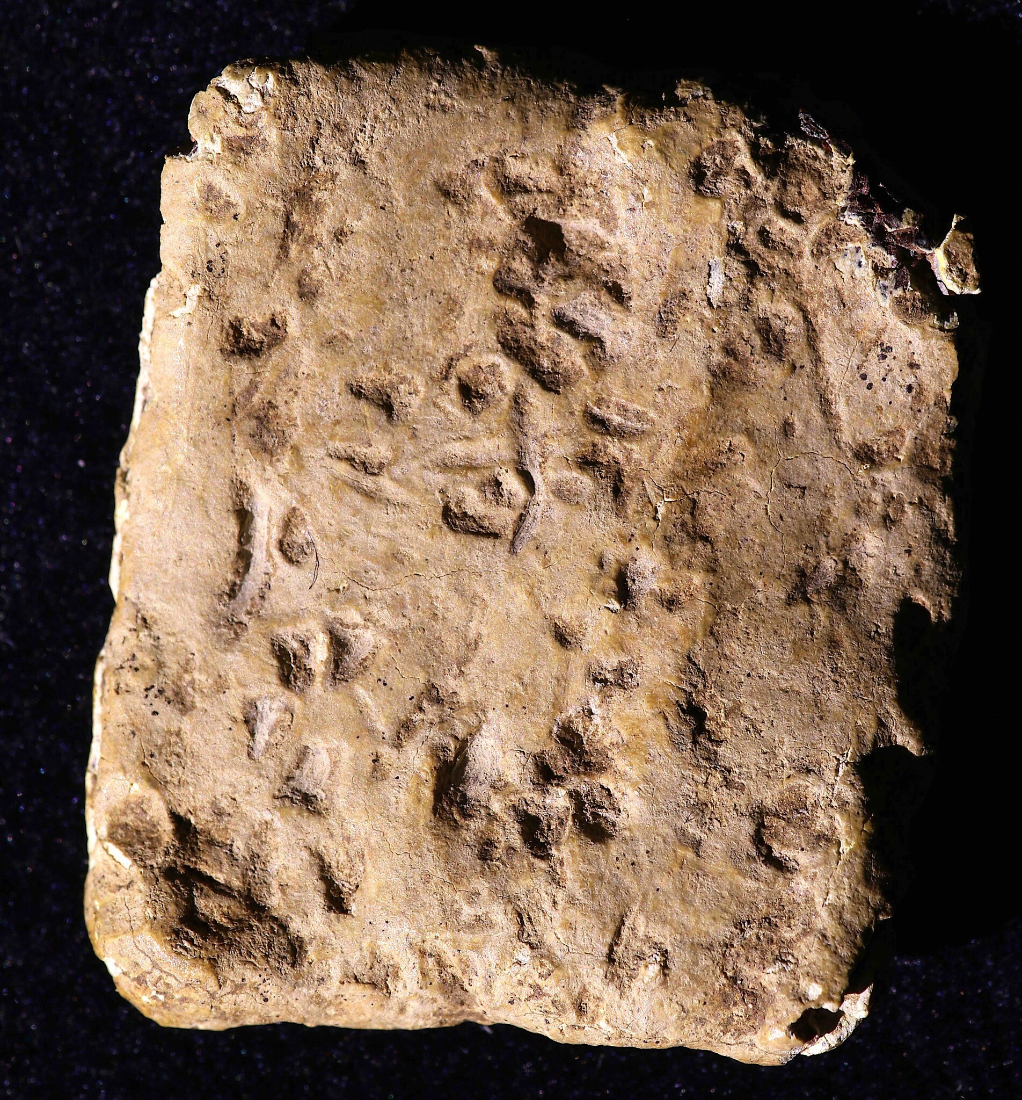
Evidence #4 - archaeology
Deut. 11:29 / 27 / Joshua 8:30-32

Slide 21
Does the Bible Stand the Test?
Content = Harmony between each book.
Writers = Willing to die for what “they had seen and heard.”
Prophecies = Specific, detailed, and fulfilled as spoken!
Archaeology = Continues to prove Bible writings are true, even today!

Slide 22
Do YOU Stand the Bible’s Test?
”Test yourselves to see if you are in the faith; examine yourselves! Or do you not recognize this about yourselves, that Jesus Christ is in you – unless indeed you fail the test.”
2 Corinthians 13:5

