Slide 1
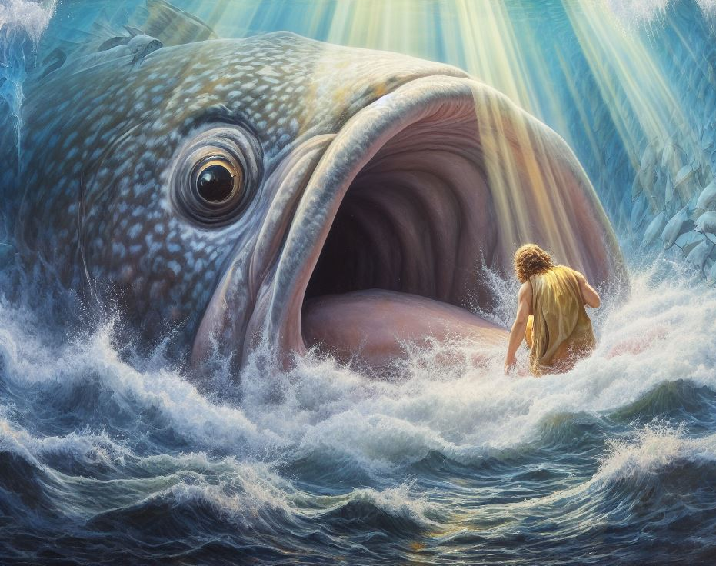
The Book of Jonah
Part Three: The God of Pity

Slide 2
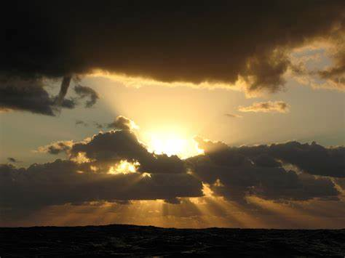
The God of Pity

Slide 3
The God of Pity
Ending Question: “Should I Not Pity Nineveh?”
Reader is left to answer the question
Account of Jonah cried out for Jewish self-reflection
And you shall be to me a kingdom of priests and a holy nation.’ These are the words that you shall speak to the people of Israel – Exodus 16:6
Nationalism had blinded them to their work
Just as Jonah had chosen evil, so had the Jews

Slide 4
Hear this word that the Lord has spoken against you, O people of Israel, against the whole family that I brought up out of the land of Egypt: “You only have I known of all the families of the earth; therefore I will punish you for all your iniquities./“Hear this word, you cows of Bashan, who are on the mountain of Samaria, who oppress the poor, who crush the needy, who say to your husbands, ‘Bring, that we may drink!’ The Lord God has sworn by his holiness that, behold, the days are coming upon you, when they shall take you away with hooks, even the last of you with fishhooks. And you shall go out through the breaches, each one straight ahead; and you shall be cast out into Harmon,” declares the Lord. – Amos 3:1-2; 4:1-3

Slide 5
The God of Pity
Ending Question: “Should I Not Pity Nineveh?”
Reader is left to answer the question
Account of Jonah cried out for Jewish self-reflection
And you shall be to me a kingdom of priests and a holy nation.’ These are the words that you shall speak to the people of Israel – Exodus 16:6
Nationalism had blinded them to their work
Just as Jonah had chosen evil, so had the Jews
They came to false conclusion they were better than others

Slide 6
The God of Pity
Ending Question: “Should I Not Pity Nineveh?”
Reader is left to answer the question
Account of Jonah cries out for our self-reflection
But you are a chosen race, a royal priesthood, a holy nation, a people for his own possession, that you may proclaim the excellencies of him who called you out of darkness into his marvelous light. – I Peter 2:9
Nationalism can cause us to lose site of our purpose
Danger in looking at “the bad guys” as unworthy of God’s attention

Slide 7
The God of Pity
Big Question: How do we handle a God who loves our enemies?
Jesus fulfilled the duty in which Israel failed
We must fulfill this duty as we become more like the Son
And now the Lord says, he who formed me from the womb to be his servant, to bring Jacob back to him; and that Israel might be gathered to him—for I am honored in the eyes of the Lord, and my God has become my strength—he says: “It is too light a thing that you should be my servant to raise up the tribes of Jacob and to bring back the preserved of Israel; I will make you as a light for the nations, that my salvation may reach to the end of the earth.” -- Isaiah 49:5-6

Slide 8
You have heard that it was said, ‘You shall love your neighbor and hate your enemy.’ But I say to you, Love your enemies and pray for those who persecute you/But I say to you who hear, Love your enemies, do good to those who hate you/But love your enemies, and do good, and lend, expecting nothing in return, and your reward will be great, and you will be sons of the Most High, for he is kind to the ungrateful and the evil. – Matthew 5:43-44; Luke 6,27,35

Slide 9
The God of Pity
Big Question: How do we handle a God who loves our enemies?
Natural result of loving enemies is kindness
Greatest act of kindness: Delivering the message of salvation
We must not fail as Jonah did
If your enemy is hungry, give him bread to eat, and if he is thirsty, give him water to drink, for you will heap burning coals on his head, and the Lord will reward you. – Proverbs 25:21-22 (cf Romans 12:20-21)

Slide 10
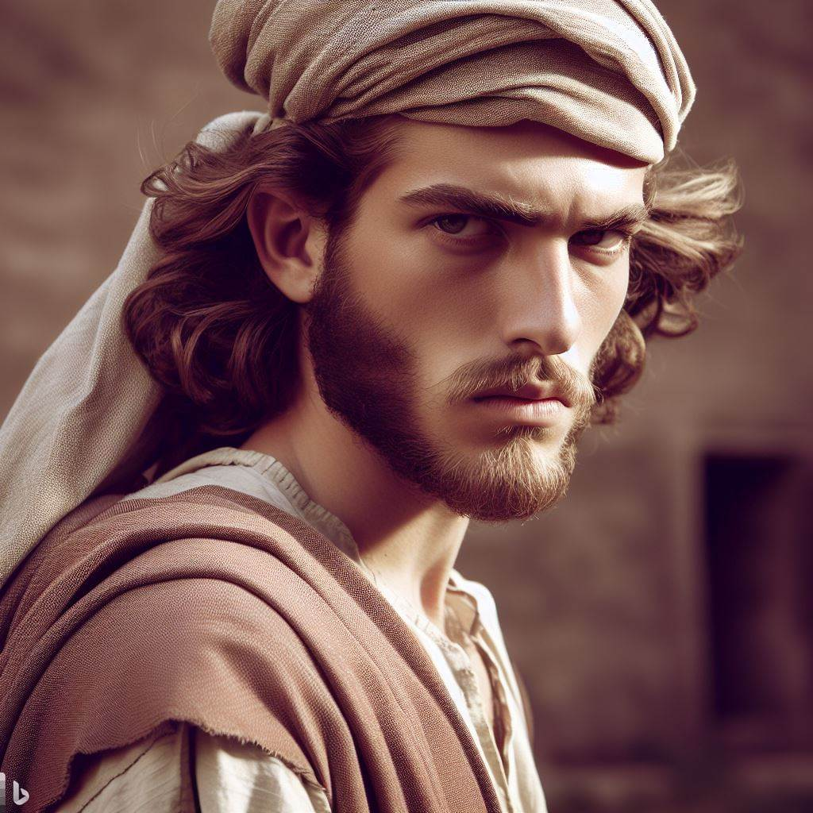
The God of Pity When We Rebel

Slide 11
The God of Pity When We Rebel
How Do We Handle Commands We Find Unpleasant?
Rebellion distorts our view of God (see Jonah 4:2)
God’s Reaction to Jonah:
Saves Jonah from himself
Addresses Jonah in reasonable terms after getting his attention
Demonstrates to him the error of his thinking
God pities us in our rebellion
The Lord is not slow to fulfill his promise as some count slowness, but is patient toward you, not wishing that any should perish, but that all should reach repentance – II Peter 3:9

Slide 12
The God of Pity When We Rebel
How Do We Handle Commands We Find Unpleasant?
Do we ignore God’s attempts to correct our attitudes?
Still being alive is proof of God’s pity
God’s pity will not last forever
But the day of the Lord will come like a thief, and then the heavens will pass away with a roar, and the heavenly bodies will be burned up and dissolved, and the earth and the works that are done on it will be exposed – II Peter 3:10

Slide 13
Seize Salvation From the God of Pity!

Slide 14
Seize Salvation From the God of Pity!
The Sailors and Ninevites did not Hesitate
Saw God as the difference between death and life
There is a danger when salvation is not viewed in this manner
Take care, brothers, lest there be in any of you an evil, unbelieving heart, leading you to fall away from the living God. But exhort one another every day, as long as it is called “today,” that none of you may be hardened by the deceitfulness of sin. – Hebrews 3:12-13

Slide 15
Seize Salvation From the God of Pity!
Accepting Salvation Means Allowing God to be Enthroned
Rebellion encourages resistance; humility encourages acceptance
Where do I stand with God?

Slide 16
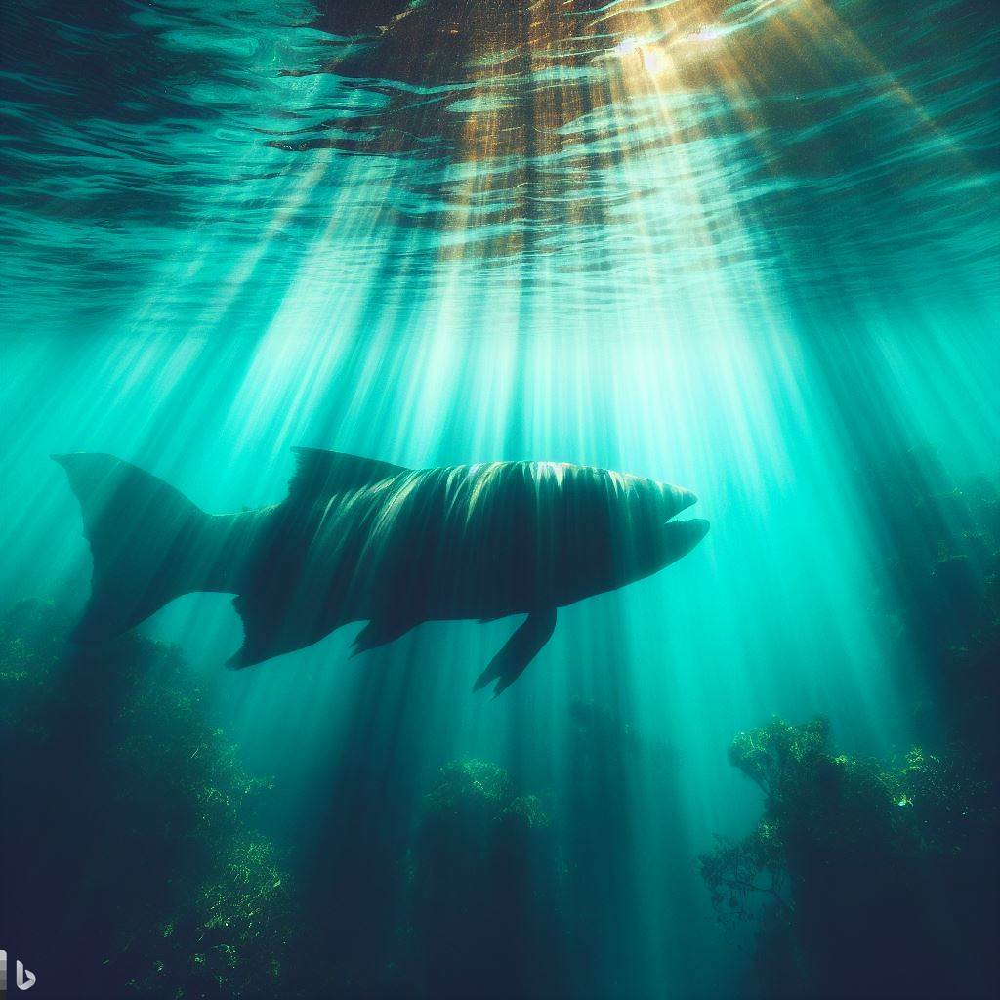
Am I More Like the Prophet or the Pagans?

