Slide 1
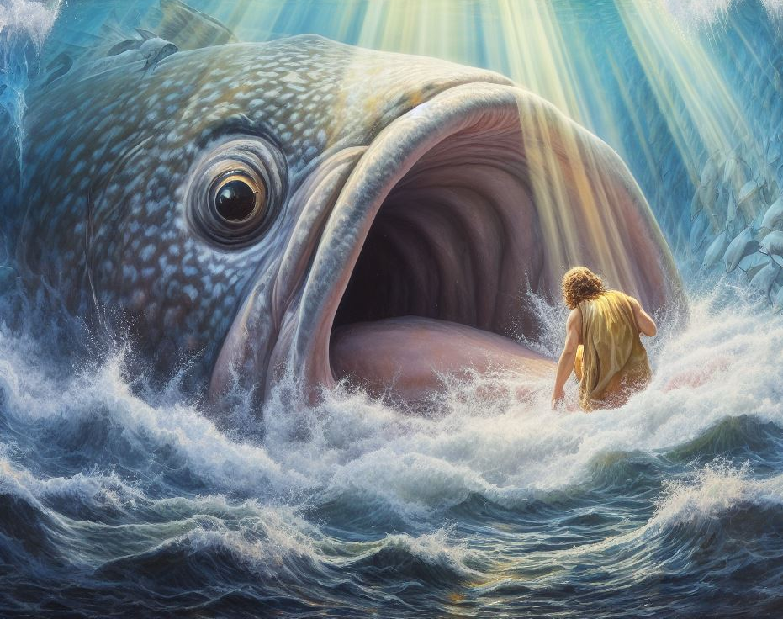
The Book of Jonah
Part One: Of Prophet and Pagans

Slide 2
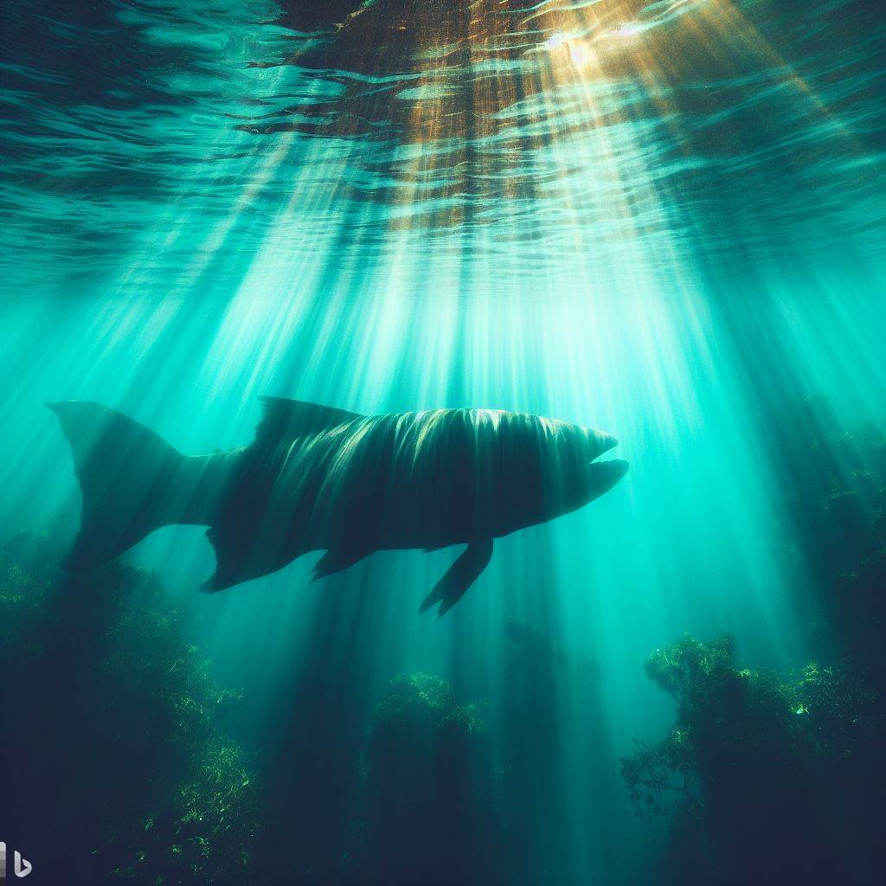
Introducing the Book
A Book about a Prophet
Only 5 words of prophecy
It is a “Great” Book

Slide 3
Nineveh, that great city
A great wind
A mighty tempest
Men were exceedingly afraid
This great tempest
Feared the Lord exceedingly
A great fish
Nineveh, that great city
An exceedingly great city
From the greatest of them
Displeased Jonah exceedingly
Jonah was exceedingly glad
Nineveh, that great city

Slide 4
Introducing the Book
A Book about a Prophet
It is a “Great” Book…Except for Jonah
Upside Down Book
Prophet is bad guy; pagans are good
Unique Structure
Parallels: Chapters 1,3/2,4
Neither fish nor Jonah is main character

Slide 5
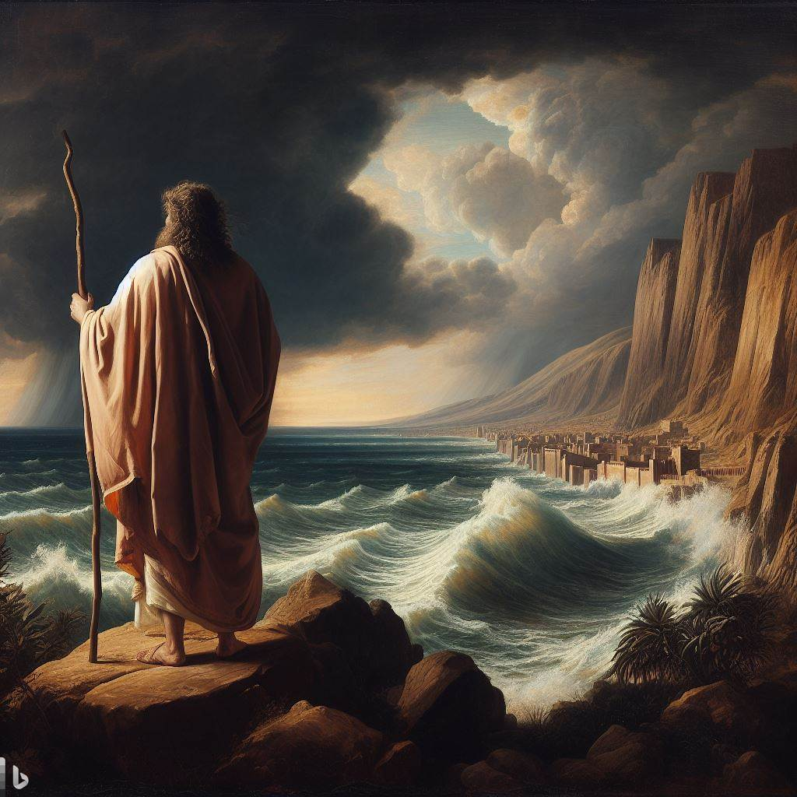
Downhill…

Slide 6
Downhill
Irony from the beginning
Jonah, the son of Amittai (Dove, the son of Faithfulness)
Called to be a foreign missionary
Did not like the call and rebelled
Things went down from here…literally!
Sought to flee to Tarshish

Slide 8
Downhill
Irony from the beginning
Jonah, the son of Amittai (Dove, the son of Faithfulness)
Called to be a foreign missionary
Did not like the call and rebelled
Things went down from here…literally!
Sought to flee to Tarshish
Resigns: “Away from the presence of the Lord”

Slide 9
Downhill
Jonah provides a picture of rebellion
Turning from God always leads downward
Problem did not begin at the point of running away
Bad ideas harden into bad actions
Warning for “good people”

Slide 10
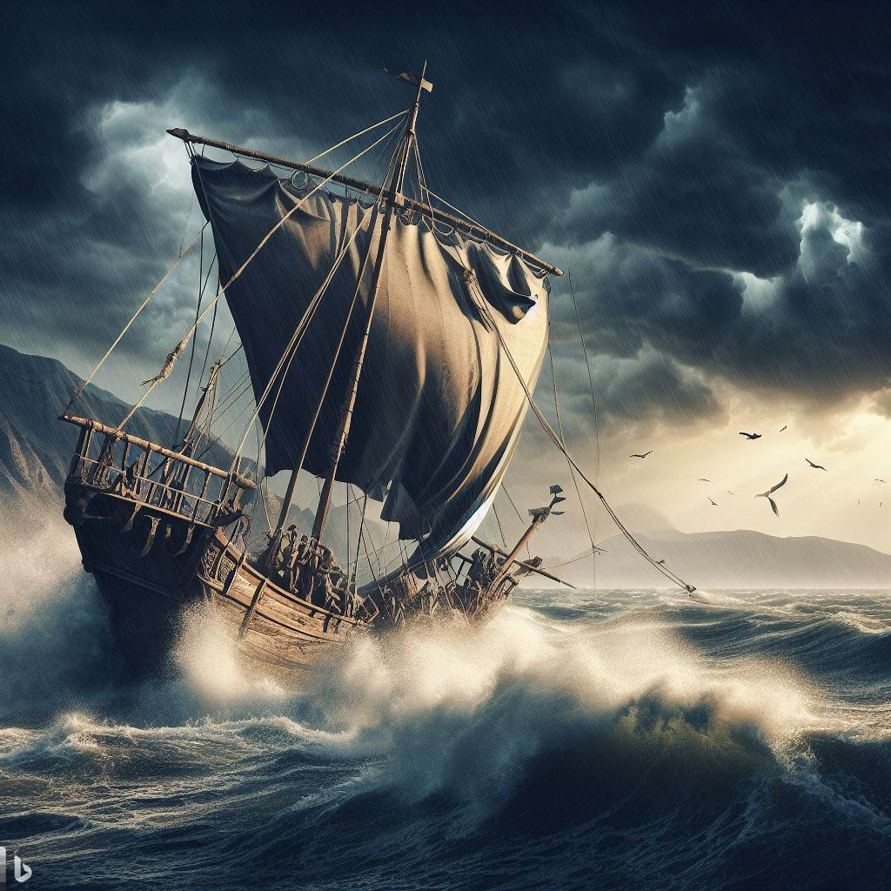
Getting the Attention of Prophet and Pagans

Slide 11
Getting the Attention of Prophet and Pagans
God hurled a great wind upon the sea
Sailors hurled contents of ship into the sea
Jonah was asleep
Prayers go up
Jonah rebuked for not praying
Talked “good religion”
Instigated “last act” of rebellion
Jonah goes down
Jonah hurled off of ship after sailors pray
Sailors vowed and sacrificed to Yahweh

Slide 12
Getting the Attention of Prophet and Pagans
Like Pagans, Like Prophet
Sailors prayed and found salvation
Jonah prayed and found salvation
Unrecorded prayer for mercy and salvation (2:9)
God provided for Jonah what God wanted to provide for Nineveh
From salvation in fish’s belly, he offered a second prayer
Sailors prayed and made vows; prophet prayed and made vows
He vowed to go to Nineveh

Slide 13
Getting the Attention of Prophet and Pagans
Getting Our Attention
Do we criticize “religious world” for doing what we should do?
Praying, evangelism, care for poor, commitment to study…
Sometimes God saves us from ourselves
Gives us our own “great fish” to think things over
We must remember this is temporary
Gives time to recommit and get back to godliness
Honor vows made in baptism
Renew those vows if we have strayed

Slide 14
Am I More Like the Prophet or the Pagans?

