Slide 1
ENCOURAGING My Brethren
LET MY LIGHT SHINE

Slide 2
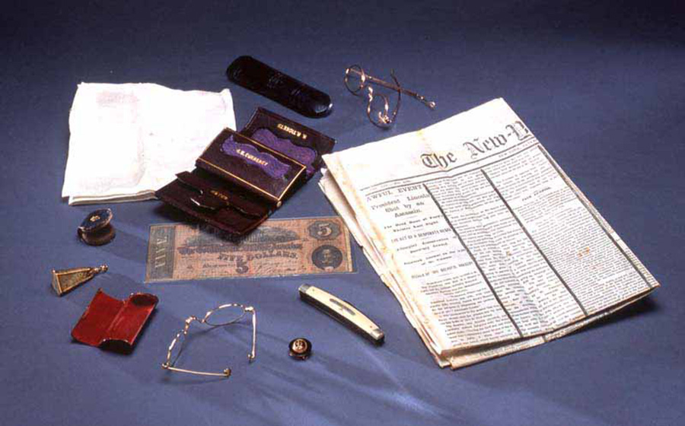
Photo via The Library of Congress

Slide 3
Photo via The Library of Congress

Slide 4
ENCOURAGING My Brethren
2 Corinthians 7:5-7
Reminders About Encouragement

Slide 5
ENCOURAGING My Brethren
2 Corinthians 7:5-7
Reminders About Encouragement
One Of Our Greatest Needs

Slide 6
ENCOURAGING My Brethren
2 Corinthians 7:5-7
Reminders About Encouragement
One Of Our Greatest Needs
One Of God’s Greatest Provisions

Slide 7
ENCOURAGING My Brethren
2 Corinthians 7:5-7
Reminders About Encouragement
One Of Our Greatest Needs
One Of God’s Greatest Provisions
One Gift That Keeps On Giving

Slide 8
2 Corinthians 1:3–4
3 Blessed be the God and Father of our Lord Jesus Christ, the Father of mercies and God of all comfort, 4 who comforts us in all our tribulation, that we may be able to comfort those who are in any trouble, with the comfort with which we ourselves are comforted by God.

Slide 9
2 Thessalonians 2:16–17
16 Now may our Lord Jesus Christ Himself, and our God and Father, who has loved us and given us everlasting consolation and good hope by grace, 17 comfort your hearts and establish you in every good word and work.

Slide 10
ENCOURAGING My Brethren
Luke 24:13-32
How Jesus Encouraged His Disciples

Slide 11
ENCOURAGING My Brethren
Luke 24:13-32
How Jesus Encouraged His Disciples
“But We Were Hoping”

Slide 12
ENCOURAGING My Brethren
Luke 24:13-32
How Jesus Encouraged His Disciples
“But We Were Hoping”
“O Foolish Ones, And Slow Of Heart To Believe”

Slide 13
ENCOURAGING My Brethren
Luke 24:13-32
How Jesus Encouraged His Disciples
“But We Were Hoping”
“O Foolish Ones, And Slow Of Heart To Believe”
“Did Not Our Heart Burn Within Us”

Slide 14
Joshua 1:8–9
8 This Book of the Law shall not depart from your mouth, but you shall meditate in it day and night, that you may observe to do according to all that is written in it. For then you will make your way prosperous, and then you will have good success. 9 Have I not commanded you? Be strong and of good courage; do not be afraid, nor be dismayed, for the LORD your God is with you wherever you go.”

Slide 15
ENCOURAGING My Brethren
Hebrews 10:19-25
How We Encourage One Another

Slide 16
ENCOURAGING My Brethren
Hebrews 10:19-25
How We Encourage One Another
Let Us Draw Near - Faith

Slide 17
ENCOURAGING My Brethren
Hebrews 10:19-25
How We Encourage One Another
Let Us Draw Near - Faith
Let Us Hold Fast - Hope

Slide 18
ENCOURAGING My Brethren
Hebrews 10:19-25
How We Encourage One Another
Let Us Draw Near - Faith
Let Us Hold Fast - Hope
Let Us Consider One Another - Love

