Slide 1
MONUMENT MEN

Slide 2
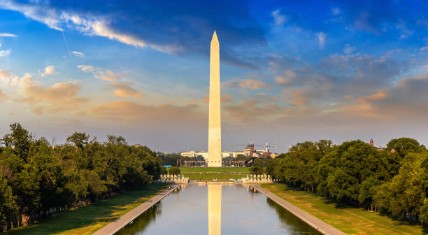
WASHINGTON MONUMENT

Slide 3
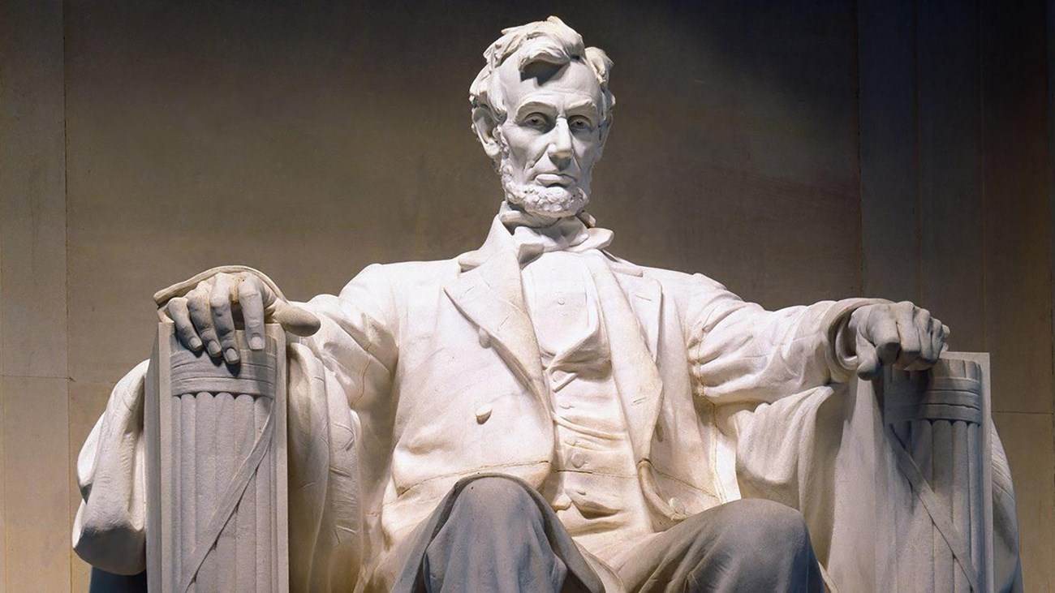
LINCOLN MEMORIAL

Slide 4
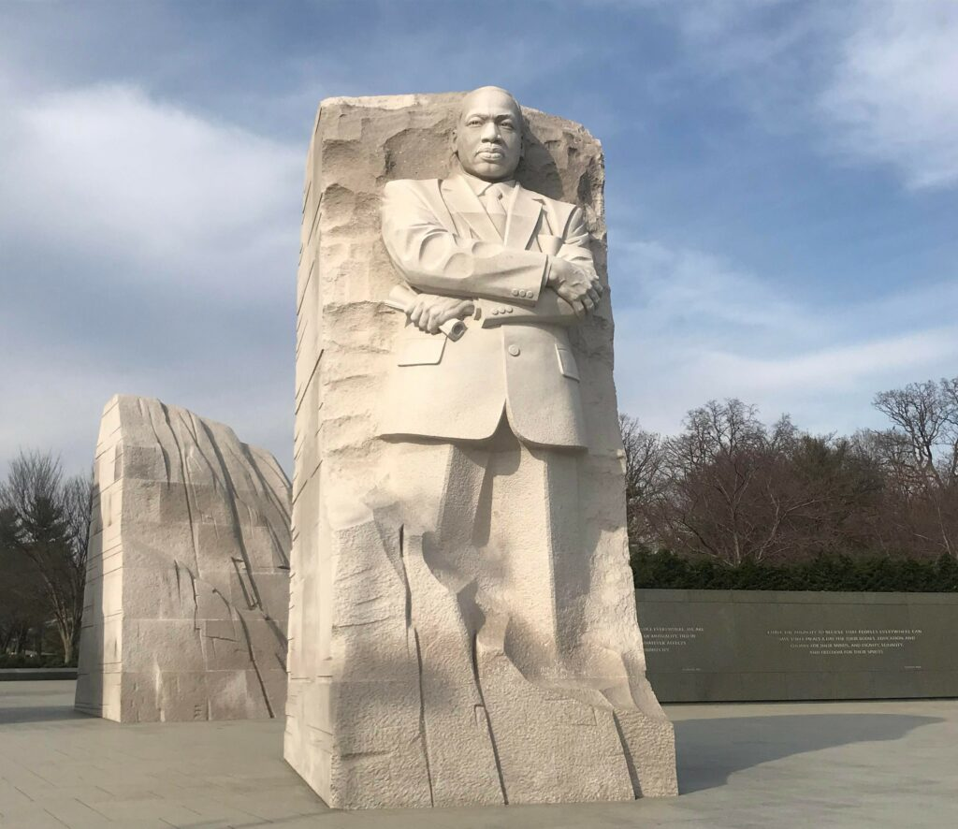
MARTIN LUTHER KING MEMORIAL

Slide 5
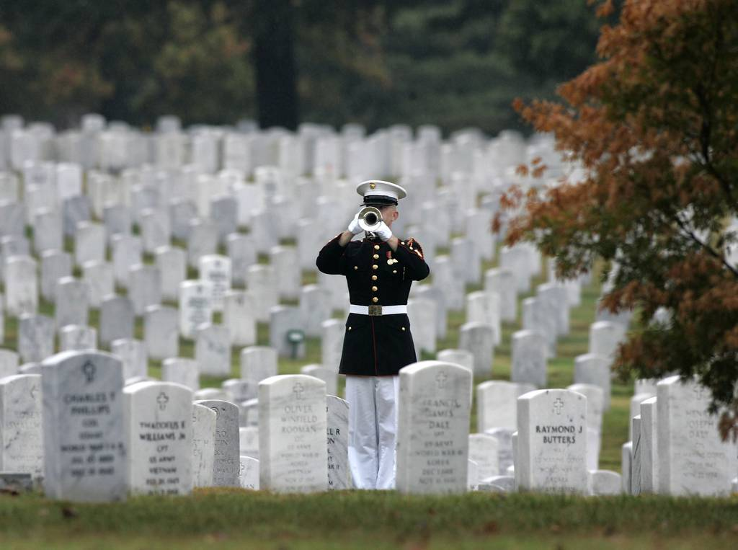
ARLINGTON CEMETERY

Slide 6
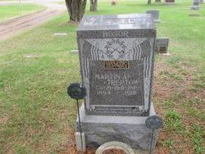
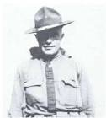
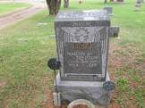
MARTIN TREPTOW

Slide 7
“MY PLEDGE”
“America must win this war. Therefore, I will work, I will save, I will sacrifice, I will endure, I will fight cheerfully and do my utmost, as if the issue of the whole struggle depended on me alone.”

Slide 8
MONUMENTS ARE AS OLD AS MEN
GEN. 28 – JACOB MADE A STONE MONUMENT AT BETHEL
GEN. 35 – JACOB PLACED A MONUMENT (PILLARE OF STONE) OF STONE AT THE GRAVE OF RACHEL
JOSHUA 4:1-8 - ISRAELITES TOOK STONES FROM THE JORDAN RIVER AND ERECTED A STONE MONUMENT IN GILAL

Slide 9
EBENEZER MONUMENT
1 SAM. – 7:12
Ebenezer means- “stone of help”
“Thus far the Lord has helped us”

Slide 10
Context
The Ark of the Covenant had been captured by the Philistines (1 Sam. 4-5)
God had brought punishment upon the Philistines
They put it on an wooden art and returned it to Israel
Arrives at Beth-sheesh were 50,070 men were struck dead
Ark taken to Kiriath-jearim to the house of Abinadab (1 Sam. 7:2)
After 20 yrs Israel cried out loud for the Lord (7:2)

Slide 11
Context
Samuel preaches to Israel and the people repent. (1 Sam. 7:3-6)
But the Philistines continue their attacks (v7)
Israel seeks God’s help and God delivers Israel (v9-11)
Samuel sets up the Ebenezer stone as a monument to God’s deliverance
“Thus far the Lord has helped us”

Slide 12
We Sing a Song About This Stone
O’ Thou Fount of Every Blessing
The song writer, Robert Robinson, was inspired by this story to remember that our God is the source of ‘every blessing’ in our life and in the life to come

Slide 13
Fount of Every Blessing
v1- Tune my heart to sing Thy grace; tune my heart to sing Thy grace
Streams of mercy, never ceasing, call for songs of loudest praise
Eph. 1:3
James 1:17
Heb. 13:15 – Indeed God is worthy of loudest praise..

Slide 14
Fount of Every Blessing
v2 – Here I raise MY EBENEZER; hither by thy help I’ve come;
And I hope by thy good measure, safely to arrive at home
Jesus sought me when a stranger, wandering from the fold of God
He to rescue me from danger interposed His precious blood
God has been our helper with our greatest need
Eph. 1:7
Rom. 8:31-32

Slide 15
Fount of Every Blessing
v3 – O to grace how great a debtor, daily I’m constrained to be! Let thy goodness like a fetter, bind my wandering heart to thee…
Saved by His grace and shackled to my Jesus
Eph. 2:8-9
1 Peter 1:3-5

