Slide 1
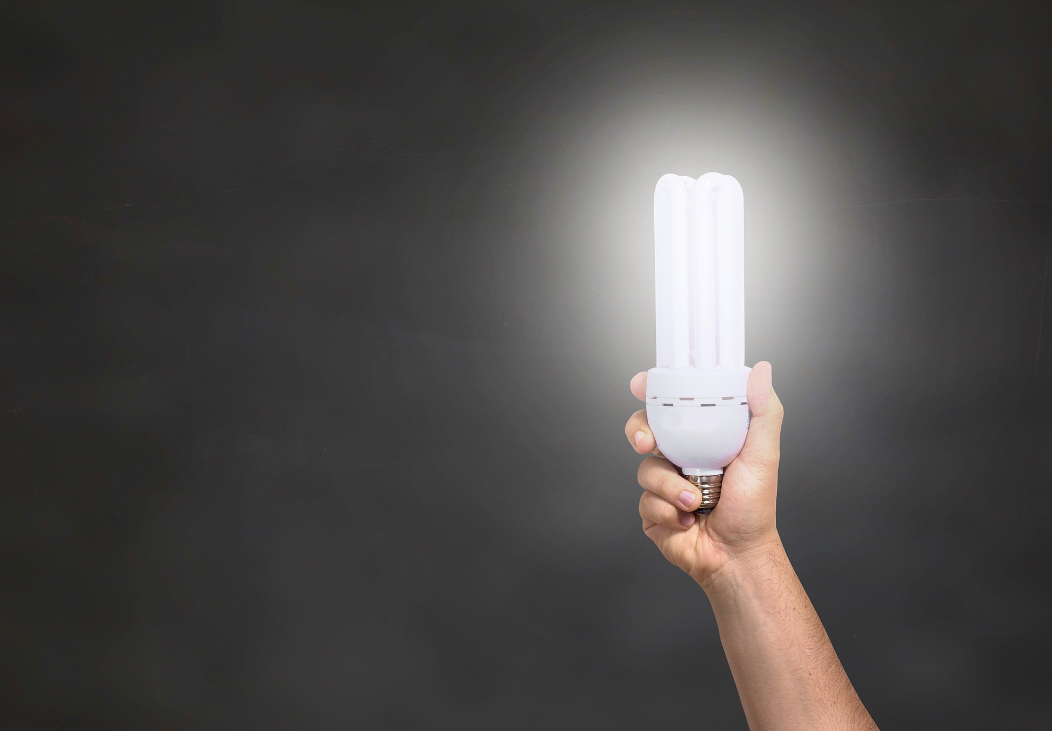
Letting our light shine
through
benevolence

Slide 2
Matt. 5:16 In the same way, let your light shine before others, so that they may see your good works and give glory to your Father who is in heaven.
Matt. 6:1 Beware of practicing your righteousness before other people in order to be seen by them, for then you will have no reward from your Father who is in heaven.

Slide 3
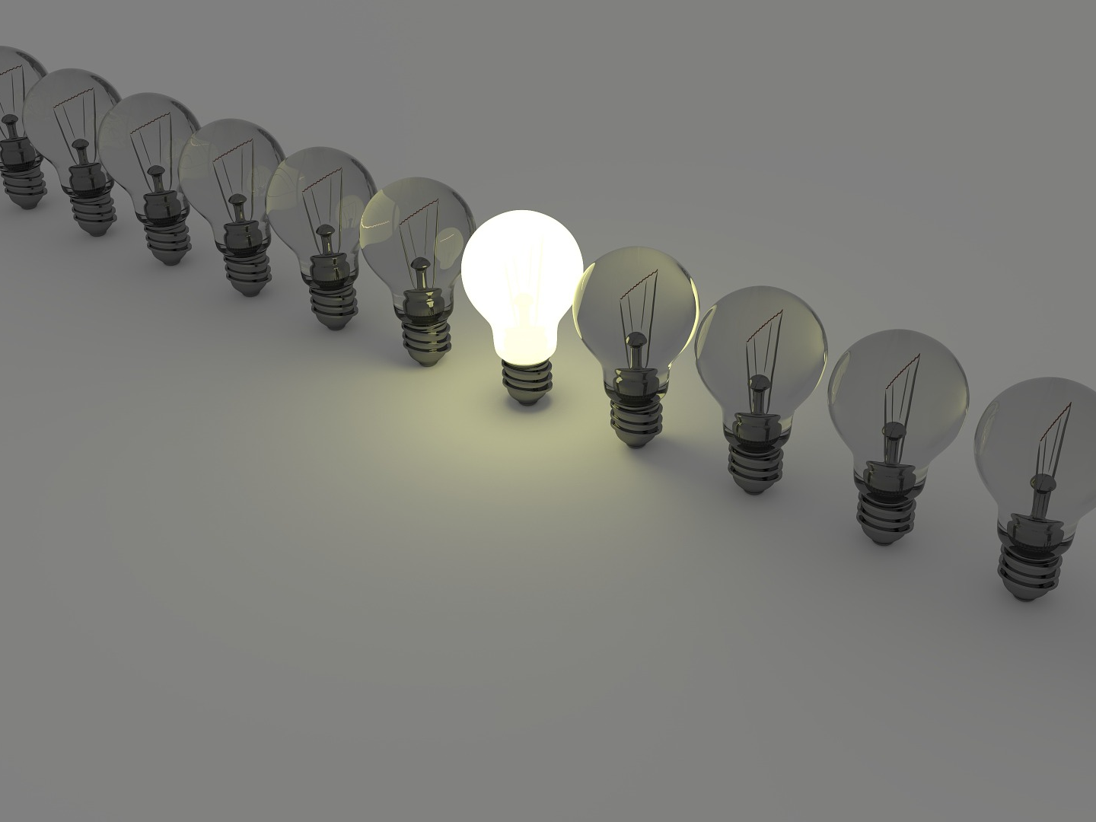

Slide 5
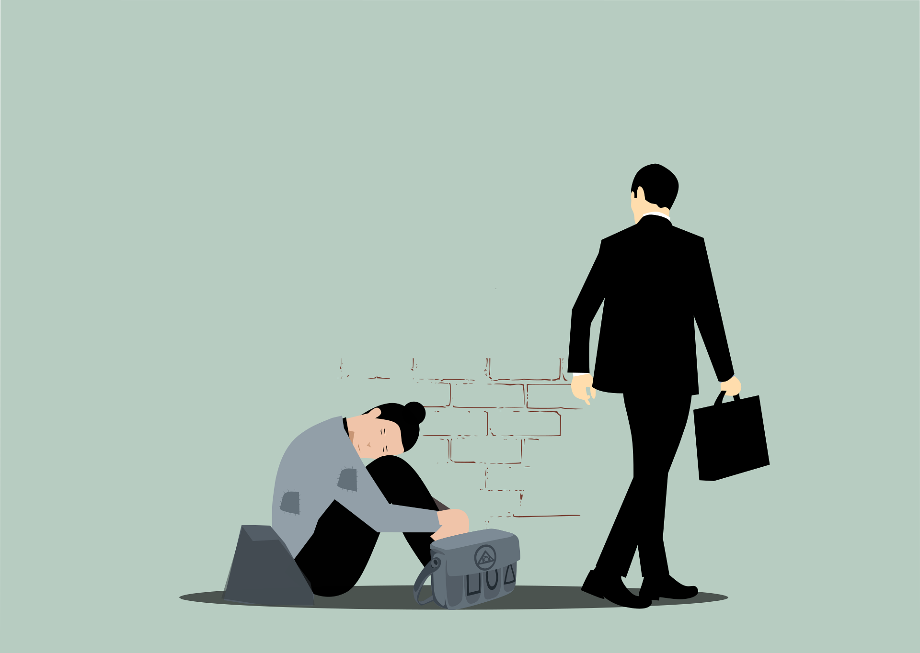

Slide 6
Isa. 58:6-8 “Is not this the fast that I choose: to loose the bonds of wickedness, to undo the straps of the yoke, to let the oppressed go free, and to break every yoke? ⁷ Is it not to share your bread with the hungry and bring the homeless poor into your house; when you see the naked, to cover him, and not to hide yourself from your own flesh? ⁸ Then shall your light break forth like the dawn, and your healing shall spring up speedily; your righteousness shall go before you; the glory of the LORD shall be your rear guard.

