Slide 1
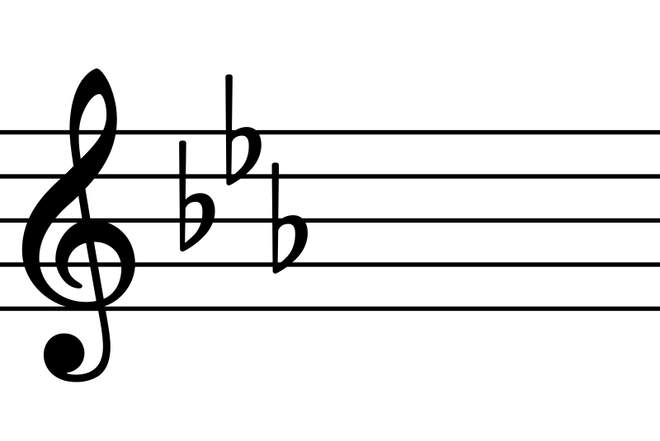
O Thou Fount Of Every Blessing

Slide 2
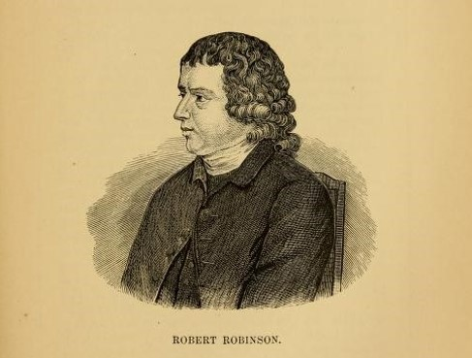
Born
Sept 27, 1735
Died
June 9, 1790
Lived in the
United Kingdom
Song written
1758
22 years old
Denominational preacher

Slide 3
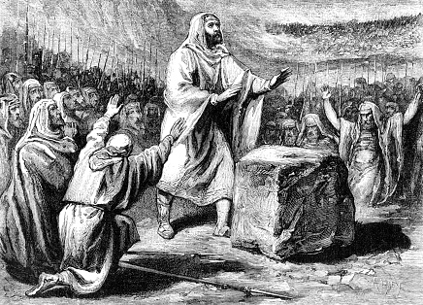
1 Samuel 7:12
Ebenezer = the stone of help
“Thus far the Lord has helped us.”
Notice the context.

Slide 4
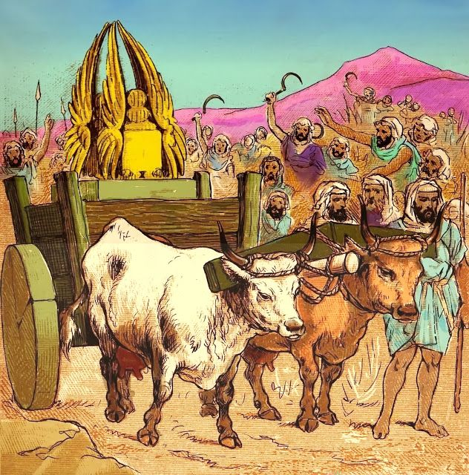
The ark taken by the Philistines during the days of Eli (1 Sam.4-5).
God judged the Philistines severely.
Philistines returned the ark on a wooden cart.
God strikes 50k+ of Beth-shemesh (1 Sam.6:19).
Ark taken to Kiriath-jearim, house of Abinadab (1 Sam.7).
After 20 yrs Israel cried out loud for the Lord (7:2).

Slide 5
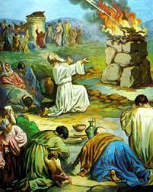
Samuel preaches to Israel (7:3).
Israel repents (v.4-6).
Philistines attack (v.7).
Israel seeks God - Samuel offers a sacrifice to God (v.9).
God delivers Israel (v.10-11).
Samuel sets up the Ebenezer stone (v.12).
“Thus far the Lord has helped us.”
God’s grace overflowed (v.13-14).

Slide 6
O Thou Fount Of Every Blessing
1 Samuel 7:12 and this song are about God’s wonderful grace upon His beloved people.

Slide 7
O Thou Fount Of Every Blessing
Verse 1: Praises the Lord as the source of every blessing.
- Zech 13:1; Eph 1:3; Jam 1:17
- Songs of loudest praise – Heb 13:15
- Why?

Slide 8
O Thou Fount Of Every Blessing
Verse 2: The Lord is our helper.
- Just as God helped Israel, He will help us too.
- Rom 8:31-32; Eph 1:7

Slide 9
O Thou Fount Of Every Blessing
Verse 3: The Lord saves us by His grace.
- Eph 2:8-9
- He protects us by His power thru faith
- 1 Pet 1:5
- Mat 6:13
- set free from sin and shackled to Jesus
- Gal 1:10

Slide 10
Born
Sept 27, 1735
Died
June 9, 1790
Lived in the
United Kingdom
Song written
1758
22 years old
“Madam, I am the unhappy man who wrote that hymn many years ago; and I would give a thousand worlds, if I had them, if I could feel now as I felt then.”
Denominational preacher
Young lady on a stagecoach.
He fell away.

Slide 11
O Thou Fount Of Every Blessing
God can be your help too.
- James 4:6-10

