Slide 2
Primitive Christianity
Defining the Word:
Relating to, denoting, or preserving the character of an early stage in the evolutionary or historical development of something
Primitive Christianity
Seeking to practice faith like those of first century

Slide 3
The Challenge To Maintain Unity On The Road To Primitive Christianity

Slide 4
Agreement & Goal
Primitivism Foundation: Bible is the Standard
All Scripture is breathed out by God and profitable for teaching, for reproof, for correction, and for training in righteousness – II Timothy 3:16

Slide 5
Agreement & Goal
Primitivism Foundation: Bible is the Standard
Knowing this first of all, that no prophecy of Scripture comes from someone's own interpretation. For no prophecy was ever produced by the will of man, but men spoke from God as they were carried along by the Holy Spirit. II Peter 1:20-21

Slide 6
Agreement & Goal
Primitivism Foundation: Bible is the Standard
And we also thank God constantly for this, that when you received the word of God, which you heard from us, you accepted it not as the word of men but as what it really is, the word of God, which is at work in you believers. – I Thessalonians 2:13

Slide 7
Agreement & Goal
Primitivism Foundation: Bible is the Standard
Do your best to present yourself to God as one approved, a worker who has no need to be ashamed, rightly handling the word of truth. -- II Timothy 2:15

Slide 8
Agreement & Goal
Primitivism Foundation: Union With Fellow Believers

Slide 9
All these with one accord were devoting themselves to prayer, together with the women and Mary the mother of Jesus, and his brothers – Acts 1:14
Only let your manner of life be worthy of the gospel of Christ, so that whether I come and see you or am absent, I may hear of you that you are standing firm in one spirit, with one mind striving side by side for the faith of the gospel – Philippians 1:27
Complete my joy by being of the same mind, having the same love, being in full accord and of one mind – Philippians 2:2
Finally, all of you, have unity of mind, sympathy, brotherly love, a tender heart, and a humble mind. -- I Peter 3:8
Eager to maintain the unity of the Spirit in the bond of peace/until we all attain to the unity of the faith and of the knowledge of the Son of God, to mature manhood, to the measure of the stature of the fullness of Christ – Ephesians 4:3,13

Slide 10
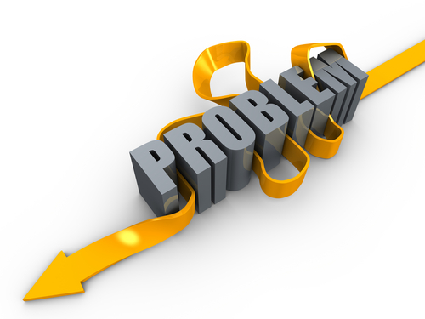
Thinking Leads to Different Conclusions
Results in “Church Camps”

Slide 11
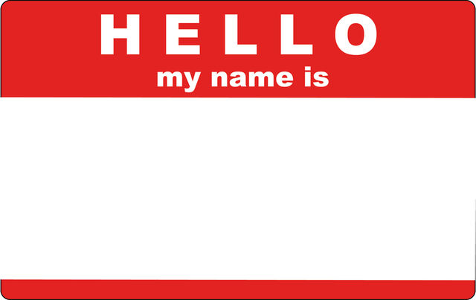
Your
Conservative
Liberal
Consiberal
Ultra-Conservative
Ultra-Liberal

Slide 12
Thinking Leads to Different Conclusions
Results in “Church Camps”
Standard becomes what others think, not God
“Undenominational denominations” develop

Slide 13
Thinking Leads to Different Conclusions
Results in “Church Camps”
New Testament churches were independent
God identified only two types of churches:
Those with Him and those against Him
Unity found in standing with God, not “camps

Slide 14
Thinking Leads to Different Conclusions
Results in Intra-Church Factionalism
With no creed, each Christian charged with finding truth
Disagreement can lead to taking sides
Each side views the other as in the wrong

Slide 15
Challenge: Attaining Unity When We Disagree
It is NOT:
Compromising truth (false unity)
Stating everyone has own truth (post-modernism)
Unwillingness to listen to disagreement

Slide 16
Challenge: Attaining Unity When We Disagree
God knew unity would not come easily:
Eager to maintain the unity of the Spirit in the bond of peace. – Ephesians 4:3

Slide 17
Challenge: Attaining Unity When We Disagree
Humility: Modest opinion of self
The other guy may be right!
Defending “my position” is not the goal
The fear of the Lord is instruction in wisdom, and humility comes before honor. – Proverbs 15:33

Slide 18
Challenge: Attaining Unity When We Disagree
Humility: Modest opinion of self
Gentleness: Power under control
Arguments not won by bullying/out-debating
Truth is sought for the good of all involved
And the Lord's servant must not be quarrelsome but kind to everyone, able to teach, patiently enduring evil, correcting his opponents with gentleness. God may perhaps grant them repentance leading to a knowledge of the truth – II Timothy 2:24-25

Slide 19
Challenge: Attaining Unity When We Disagree
Humility: Modest opinion of self
Gentleness: Power under control
Patience: Long-suffering
Recognition of different levels of maturity
But I received mercy for this reason, that in me, as the foremost, Jesus Christ might display his perfect patience as an example to those who were to believe in him for eternal life. -- I Timothy 1:16

Slide 20
Challenge: Attaining Unity When We Disagree
Humility: Modest opinion of self
Gentleness: Power under control
Patience: Long-suffering
Bearing With One Another: Tolerating
Liberty given up for another’s conscience
Bearing with one another and, if one has a complaint against another, forgiving each other; as the Lord has forgiven you, so you also must forgive – Colossians 3:13

Slide 21
