Slide 3
I Cannot Follow All Those Rules

Slide 4
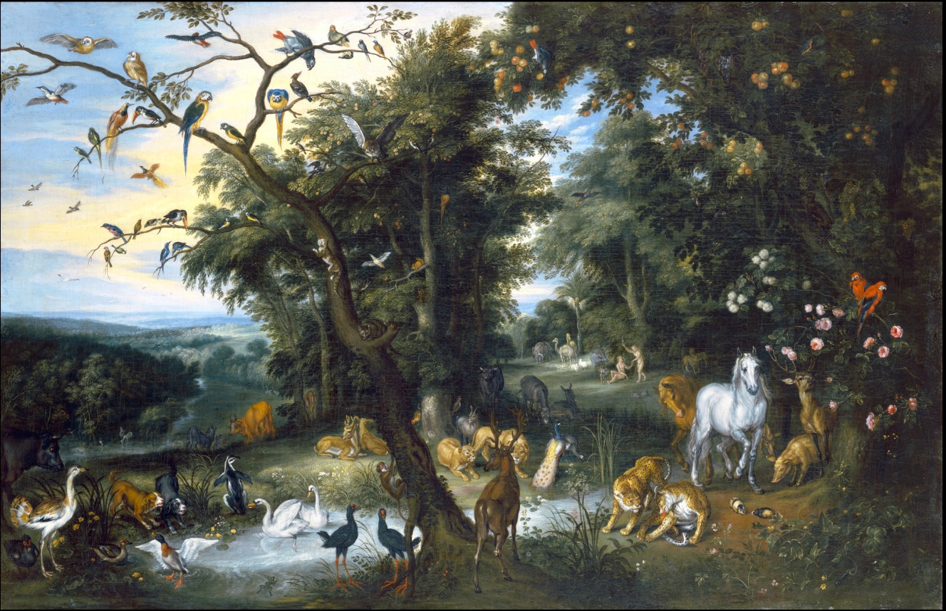
Failure in the Garden

Slide 5
Failure in the Garden
God’s Noble Purpose for Creating Humans
And God blessed them. And God said to them, “Be fruitful and multiply and fill the earth and subdue it, and have dominion over the fish of the sea and over the birds of the heavens and over every living thing that moves on the earth.” – Genesis 1:28

Slide 6
Failure in the Garden
God’s Noble Purpose for Creating Humans
This partnership required learning God’s wisdom
But of the tree of the knowledge of good and evil you shall not eat, for in the day that you eat of it you shall surely die (2:17)
Good and evil must be learned from God’s standard

Slide 7
Failure in the Garden
God’s Noble Purpose for Creating Humans
Serpent’s temptation: Self-define good and evil
For God knows that when you eat of it your eyes will be opened, and you will be like God, knowing good and evil (3:5)
Human failure led to exile from the Garden

Slide 8
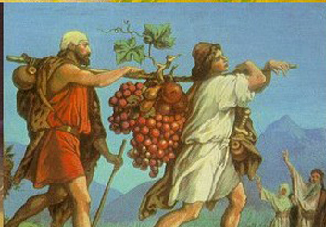
Israel’s Nationhood: The Garden, Part 2

Slide 9
Israel’s Nationhood: The Garden, Part 2
God’s Noble Purpose for Choosing Israel
Now therefore, if you will indeed obey my voice and keep my covenant, you shall be my treasured possession among all peoples, for all the earth is mine; and you shall be to me a kingdom of priests and a holy nation.’ These are the words that you shall speak to the people of Israel – Exodus 19:5-6
All the people answered together and said, “All that the Lord has spoken we will do.” And Moses reported the words of the people to the Lord (vs. 8)
An Example for the Nations

Slide 10
Israel’s Nationhood: The Garden, Part 2
“All Those Rules…”
Purpose of God’s laws for Israel:
You shall love the Lord your God with all your heart and with all your soul and with all your might/You shall not take vengeance or bear a grudge against the sons of your own people, but you shall love your neighbor as yourself: I am the Lord – Deuteronomy 6:5; Leviticus 19:18; cf Matthew 22:37-40
Laws were not arbitrary rules for testing
They taught how to love God and love one’s neighbor

Slide 11
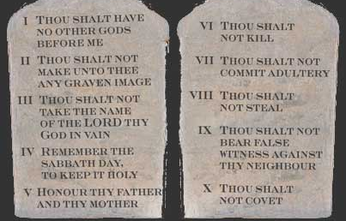

Slide 12
Israel’s Nationhood: The Garden, Part 2
“All Those Rules…”
Purpose of God’s laws for Israel:
Same purpose as in the Garden: Seek God’s wisdom

Slide 13
Israel’s Nationhood: The Garden, Part 2
Israel’s actions mimicked those of Adam and Eve
Exodus 19-Deuteronomy: Narrative of self-desire
Moses warned they must seek God’s wisdom

Slide 14
The Lord your God will make you abundantly prosperous in all the work of your hand, in the fruit of your womb and in the fruit of your cattle and in the fruit of your ground. For the Lord will again take delight in prospering you, as he took delight in your fathers, when you obey the voice of the Lord your God, to keep his commandments and his statutes that are written in this Book of the Law, when you turn to the Lord your God with all your heart and with all your soul. “For this commandment that I command you today is not too hard for you, neither is it far off. It is not in heaven, that you should say, ‘Who will ascend to heaven for us and bring it to us, that we may hear it and do it?’ Neither is it beyond the sea, that you should say, ‘Who will go over the sea for us and bring it to us, that we may hear it and do it?’ But the word is very near you. It is in your mouth and in your heart, so that you can do it. “See, I have set before you today life and good, death and evil. If you obey the commandments of the Lord your God that I command you today, by loving the Lord your God, by walking in his ways, and by keeping his commandments and his statutes and his rules, then you shall live and multiply, and the Lord your God will bless you in the land that you are entering to take possession of it. – Deuteronomy 30:9-16

Slide 15
The Lord your God will make you abundantly prosperous in all the work of your hand, in the fruit of your womb and in the fruit of your cattle and in the fruit of your ground. For the Lord will again take delight in prospering you, as he took delight in your fathers, when you obey the voice of the Lord your God, to keep his commandments and his statutes that are written in this Book of the Law, when you turn to the Lord your God with all your heart and with all your soul. “For this commandment that I command you today is not too hard for you, neither is it far off. It is not in heaven, that you should say, ‘Who will ascend to heaven for us and bring it to us, that we may hear it and do it?’ Neither is it beyond the sea, that you should say, ‘Who will go over the sea for us and bring it to us, that we may hear it and do it?’ But the word is very near you. It is in your mouth and in your heart, so that you can do it. “See, I have set before you today life and good, death and evil. If you obey the commandments of the Lord your God that I command you today, by loving the Lord your God, by walking in his ways, and by keeping his commandments and his statutes and his rules, then you shall live and multiply, and the Lord your God will bless you in the land that you are entering to take possession of it. – Deuteronomy 30:9-16

Slide 16
Israel’s Nationhood: The Garden, Part 2
Israel’s actions mimicked those of Adam and Eve
Exodus 19-Deuteronomy: Narrative of self-desire
Moses warned they must seek God’s wisdom
Like Adam and Eve, Israel failed
Israel exiled from the good land God had given them

Slide 17
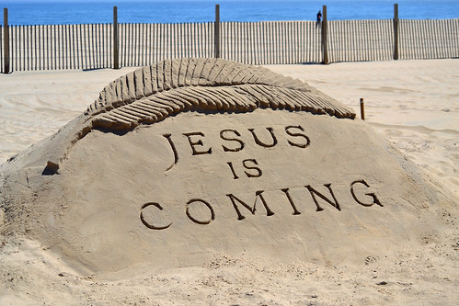
Jesus to the Rescue

Slide 18
Jesus to the Rescue
Jesus Demonstrated How Obedience is to Look
“Do not think that I have come to abolish the Law or the Prophets; I have not come to abolish them but to fulfill them. For truly, I say to you, until heaven and earth pass away, not an iota, not a dot, will pass from the Law until all is accomplished. Therefore whoever relaxes one of the least of these commandments and teaches others to do the same will be called least in the kingdom of heaven, but whoever does them and teaches them will be called great in the kingdom of heaven. For I tell you, unless your righteousness exceeds that of the scribes and Pharisees, you will never enter the kingdom of heaven. – Matthew 5:17-20
His Obedience Provides a Better Way for Us

Slide 19
But as it is, Christ has obtained a ministry that is as much more excellent than the old as the covenant he mediates is better, since it is enacted on better promises. For if that first covenant had been faultless, there would have been no occasion to look for a second. For he finds fault with them when he says:
“Behold, the days are coming, declares the Lord, when I will establish a new covenant with the house of Israel and with the house of Judah, not like the covenant that I made with their fathers on the day when I took them by the hand to bring them out of the land of Egypt. For they did not continue in my covenant, and so I showed no concern for them, declares the Lord. For this is the covenant that I will make with the house of Israel after those days, declares the Lord: I will put my laws into their minds, and write them on their hearts, and I will be their God, and they shall be my people. -- Hebrews 8:6-10

Slide 20
Jesus to the Rescue
New Covenant: Same Goals – Love God and Neighbor
If you love me, you will keep my commandments (John 14:15)
Whoever has my commandments and keeps them, he it is who loves me. And he who loves me will be loved by my Father, and I will love him and manifest myself to him.(21)
Jesus answered him, “If anyone loves me, he will keep my word, and my Father will love him, and we will come to him and make our home with him (23)
Whoever does not love me does not keep my words. And the word that you hear is not mine but the Father's who sent me (24)

Slide 21
Getting Back to Eden

Slide 22
Getting Back to Eden
What About Commands of the New Covenant?
Jesus provides the model of how to obey
He demonstrates the purpose behind the command
You have heard that it was said to those of old, ‘You shall not murder; and whoever murders will be liable to judgment.’ But I say to you that everyone who is angry with his brother will be liable to judgment; whoever insults his brother will be liable to the council; and whoever says, ‘You fool!’ will be liable to the hell of fire. So if you are offering your gift at the altar and there remember that your brother has something against you… – Matthew 5:21-23

Slide 23
Getting Back to Eden
What About Commands of the New Covenant?
Must not approach commands like a driver’s manual!
Faithful to the covenant by seeking to be like Jesus
Unlike the people of Eden and Israel, seek God’s wisdom
I must let God define good and evil

Slide 24
For it is written,
“I will destroy the wisdom of the wise, and the discernment of the discerning I will thwart.”
Where is the one who is wise? Where is the scribe? Where is the debater of this age? Has not God made foolish the wisdom of the world? For since, in the wisdom of God, the world did not know God through wisdom, it pleased God through the folly of what we preach to save those who believe. For Jews demand signs and Greeks seek wisdom, but we preach Christ crucified, a stumbling block to Jews and folly to Gentiles, but to those who are called, both Jews and Greeks, Christ the power of God and the wisdom of God -- I Corinthians 1:19-24

